Slide 1
Energetic events following magnetic flux emergence into the photosphere
Luc Rouppe van der Voort
Rosseland Centre for Solar Physics (RoCS), University of Oslo
In collaboration with Mats Ola Sand, Ignasi Soler Poquet, Souvik Bose, Daniel Nóbrega-Siverio, Reetika Joshi, Jonas Thoen Faber
EAS 2026, Lausanne

Slide 2
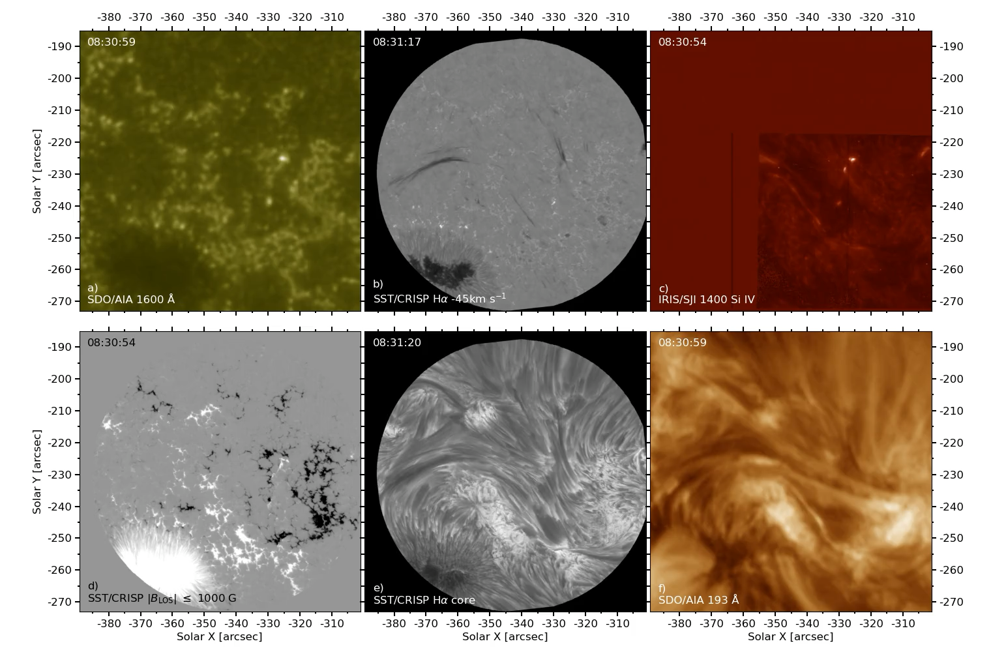
Coordinated observations
SST & IRIS,
SDO, Hinode

Slide 3
Coordinated observations
SST & IRIS,
SDO, Hinode

Slide 4
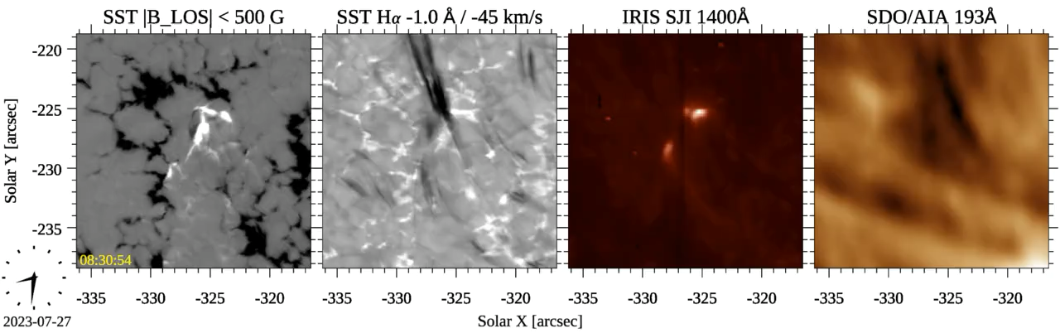
Si IV

Slide 5
Si IV
Flux emergence

Slide 6
Si IV
Flux emergence
Ellerman bombs
Dome
Surge

Slide 7
Si IV
Flux emergence
Ellerman bombs
Dome
Surge
UV burst
Dome

Slide 8
Si IV
Flux emergence
Ellerman bombs
Dome
Surge
UV burst
Dome
UV burst
Dome
Surge

Slide 9
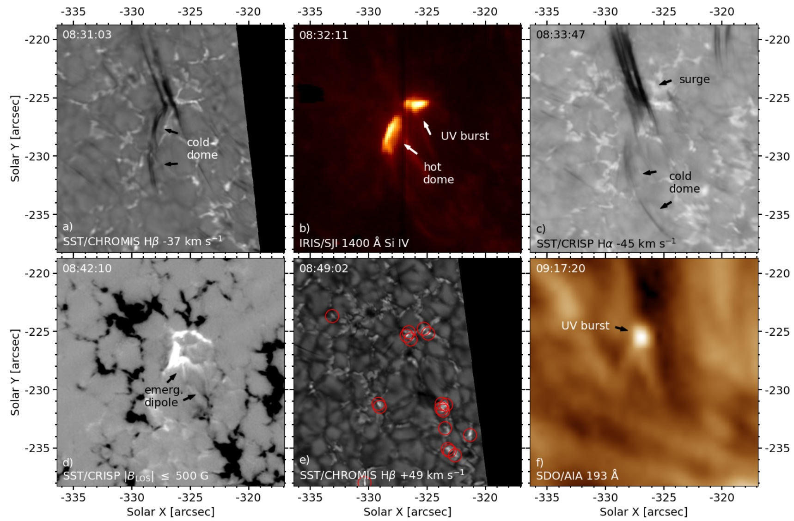
Ellerman bombs

Slide 10
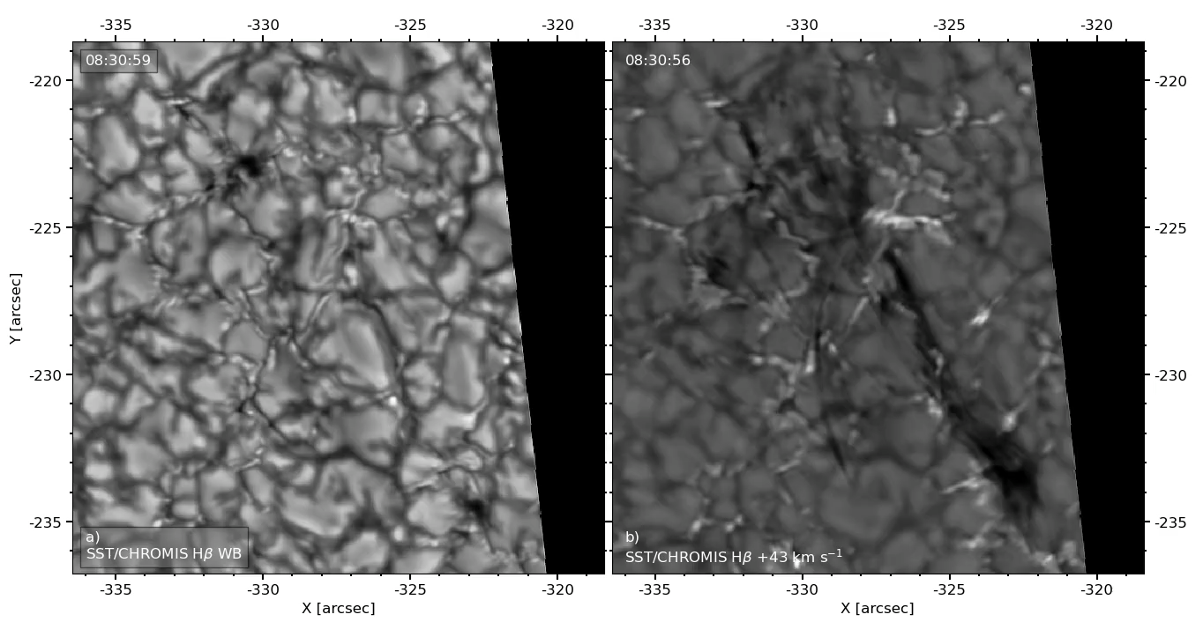
Plasmoid-like blobs in dome
Wideband
Hβ wing

Slide 11
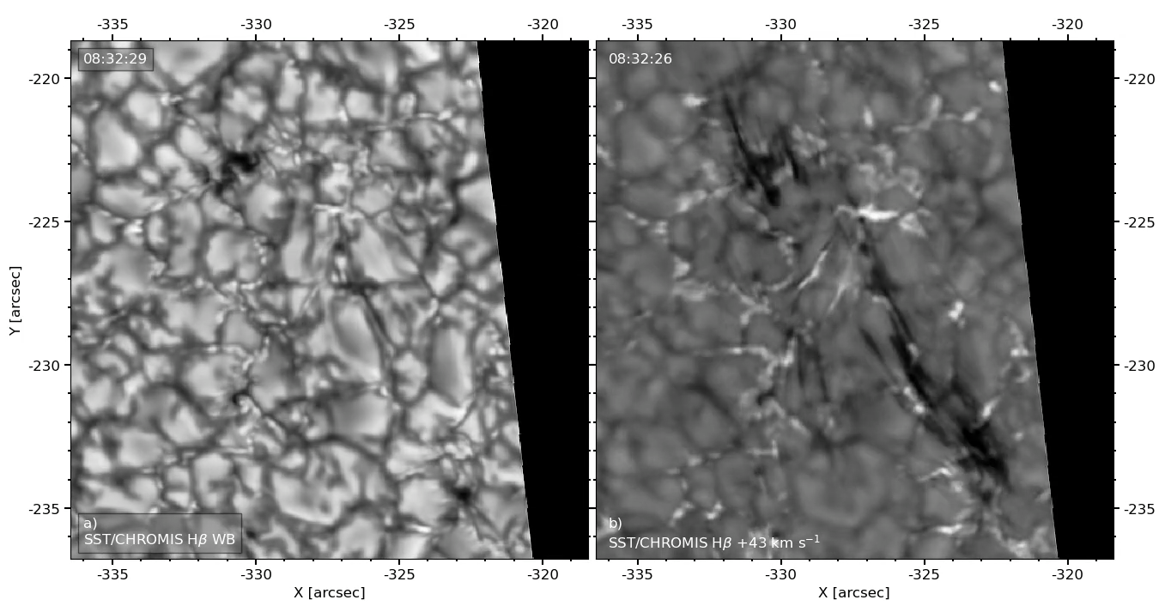
Plasmoid-like blobs in dome
Wideband
Hβ wing

Slide 12
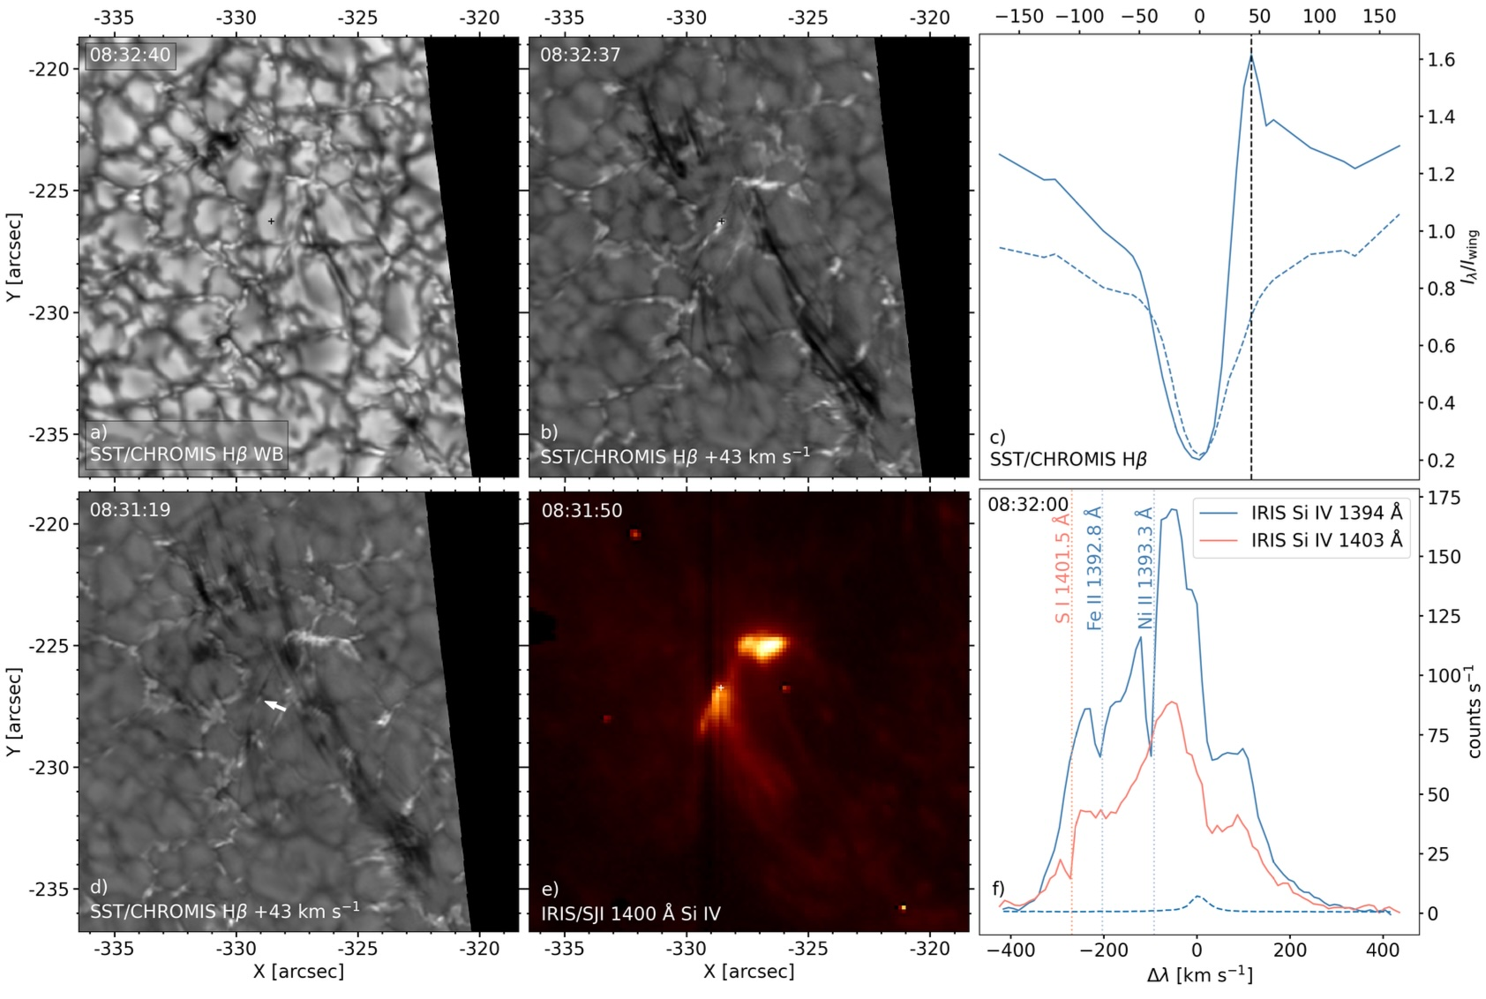
Doppler: +43 km/s

Slide 13
Doppler: +43 km/s
Doppler:
+100 km/s and
-220 km/s

Slide 14
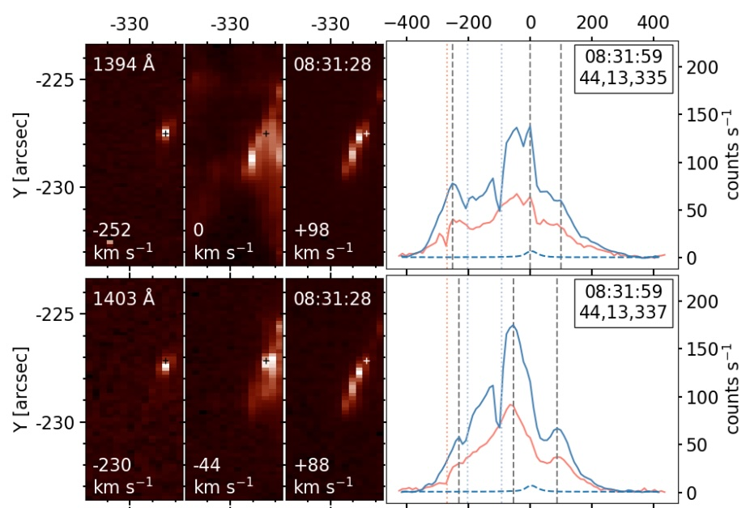
IRIS Si IV raster maps
Complex Si IV profiles:
non-Gaussian and multiple components
Maps show small blobs with large Doppler offsets

Slide 15
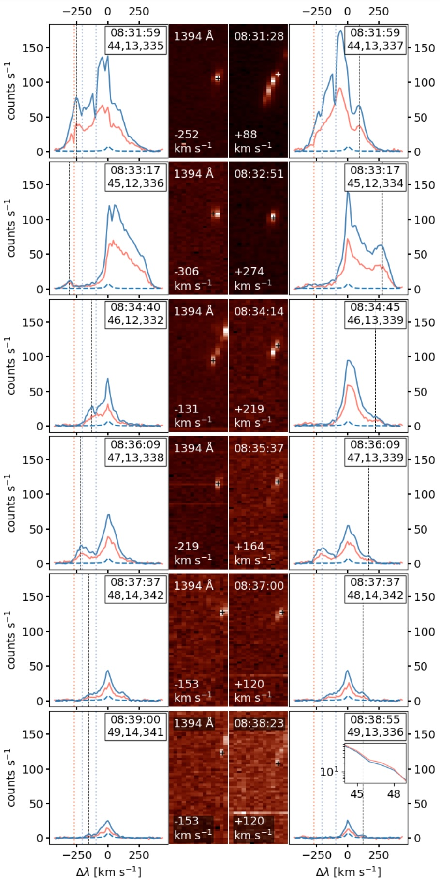
Complex Si IV profiles:
non-Gaussian and multiple components
←time
Maps show small blobs with large Doppler offsets

Slide 16
Complex Si IV profiles:
non-Gaussian and multiple components
←time
Maps show small blobs with large Doppler offsets

Slide 17
Complex Si IV profiles:
non-Gaussian and multiple components
←time
Maps show small blobs with large Doppler offsets

Slide 18
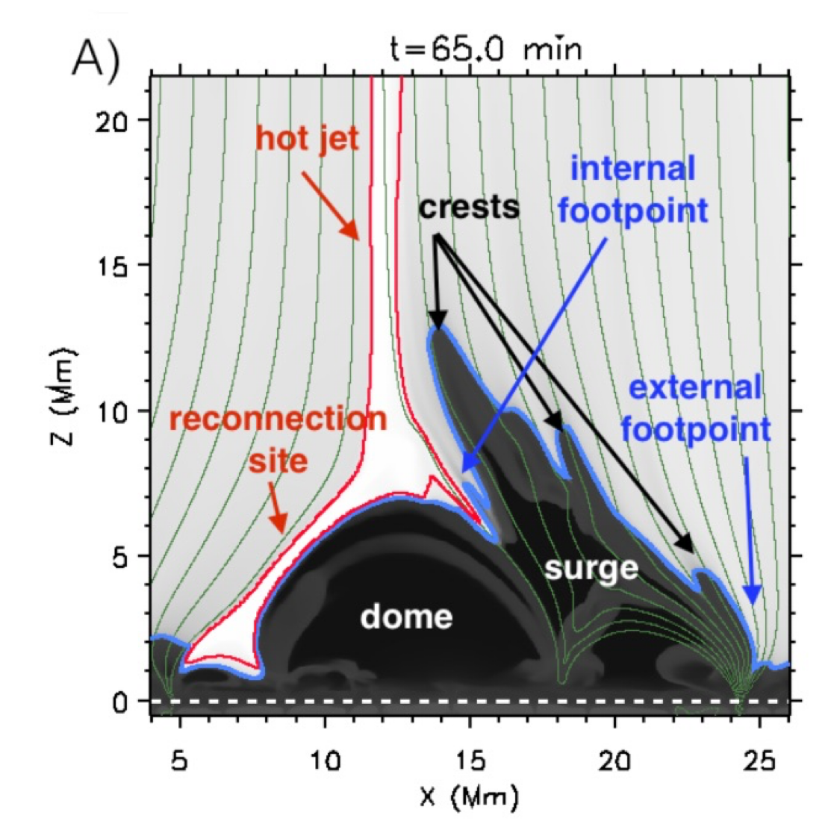
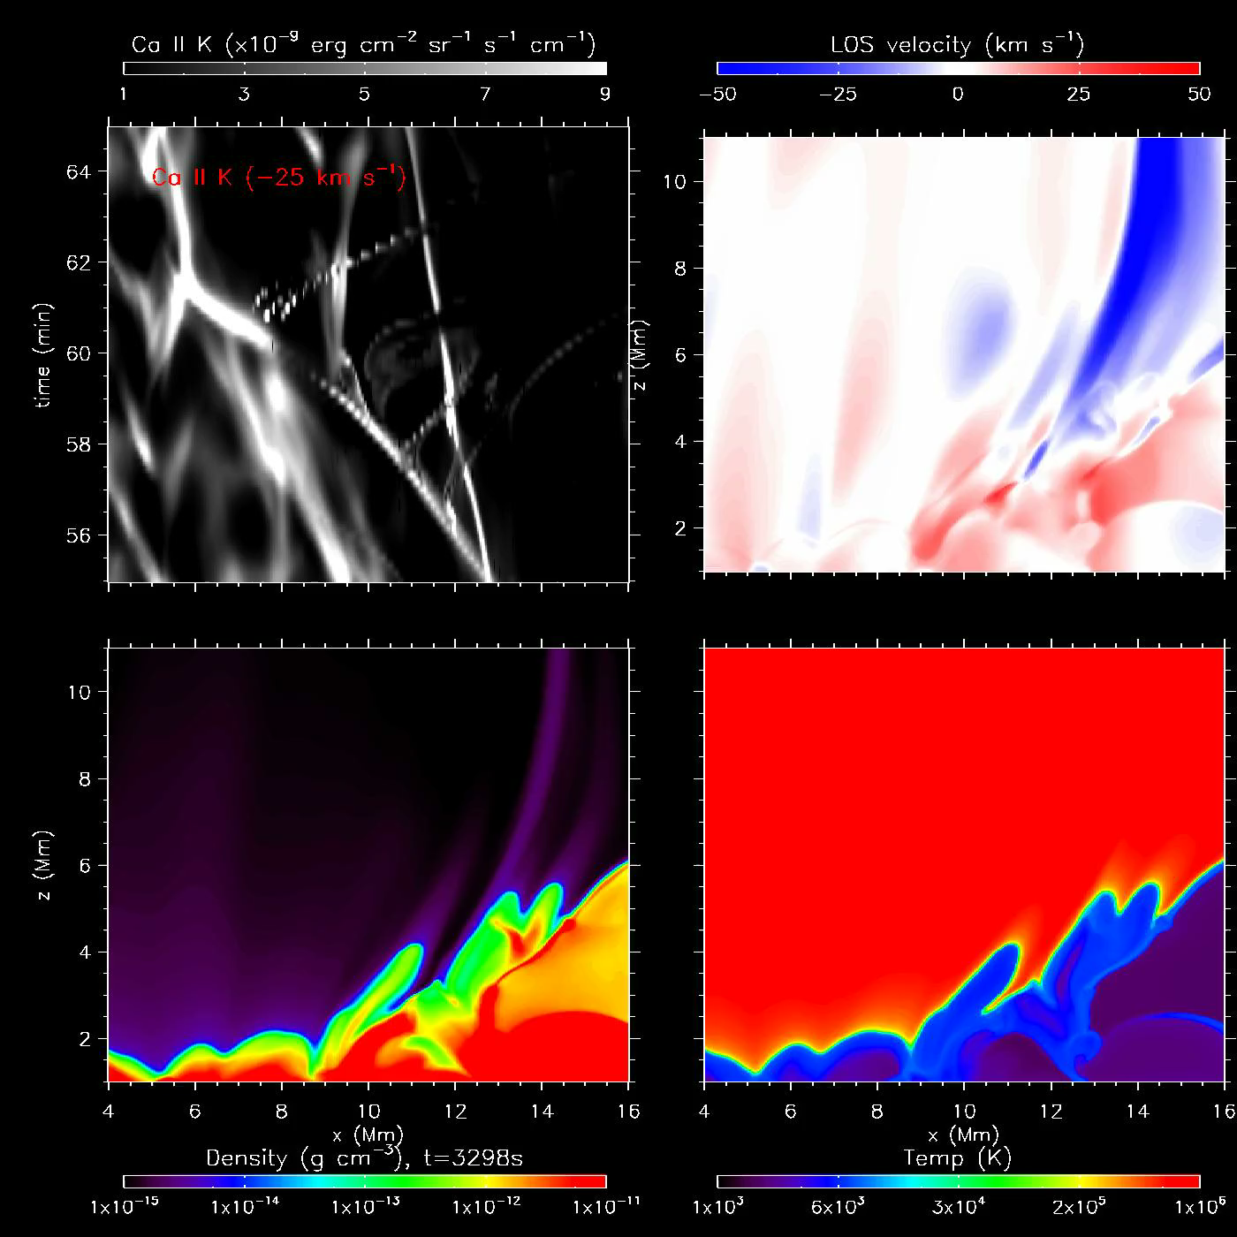
Nobrega-Siverio et al. 2017
2.5D Bifrost rMHD simulation of emergence
of twisted magnetic flux tube
→reconnection with ambient field
→plasmoids
Rouppe van der Voort et al. 2017

Slide 19
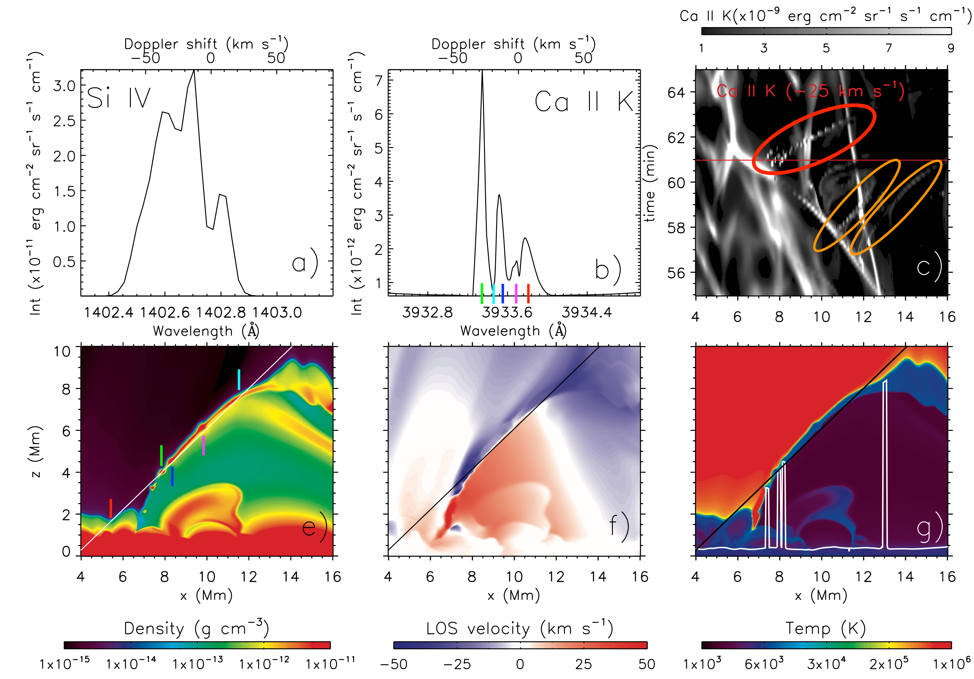
Plasmoids in current sheet produce complex spectral profiles
Rouppe van der Voort et al. 2017 ApJL 851 L6

Slide 20
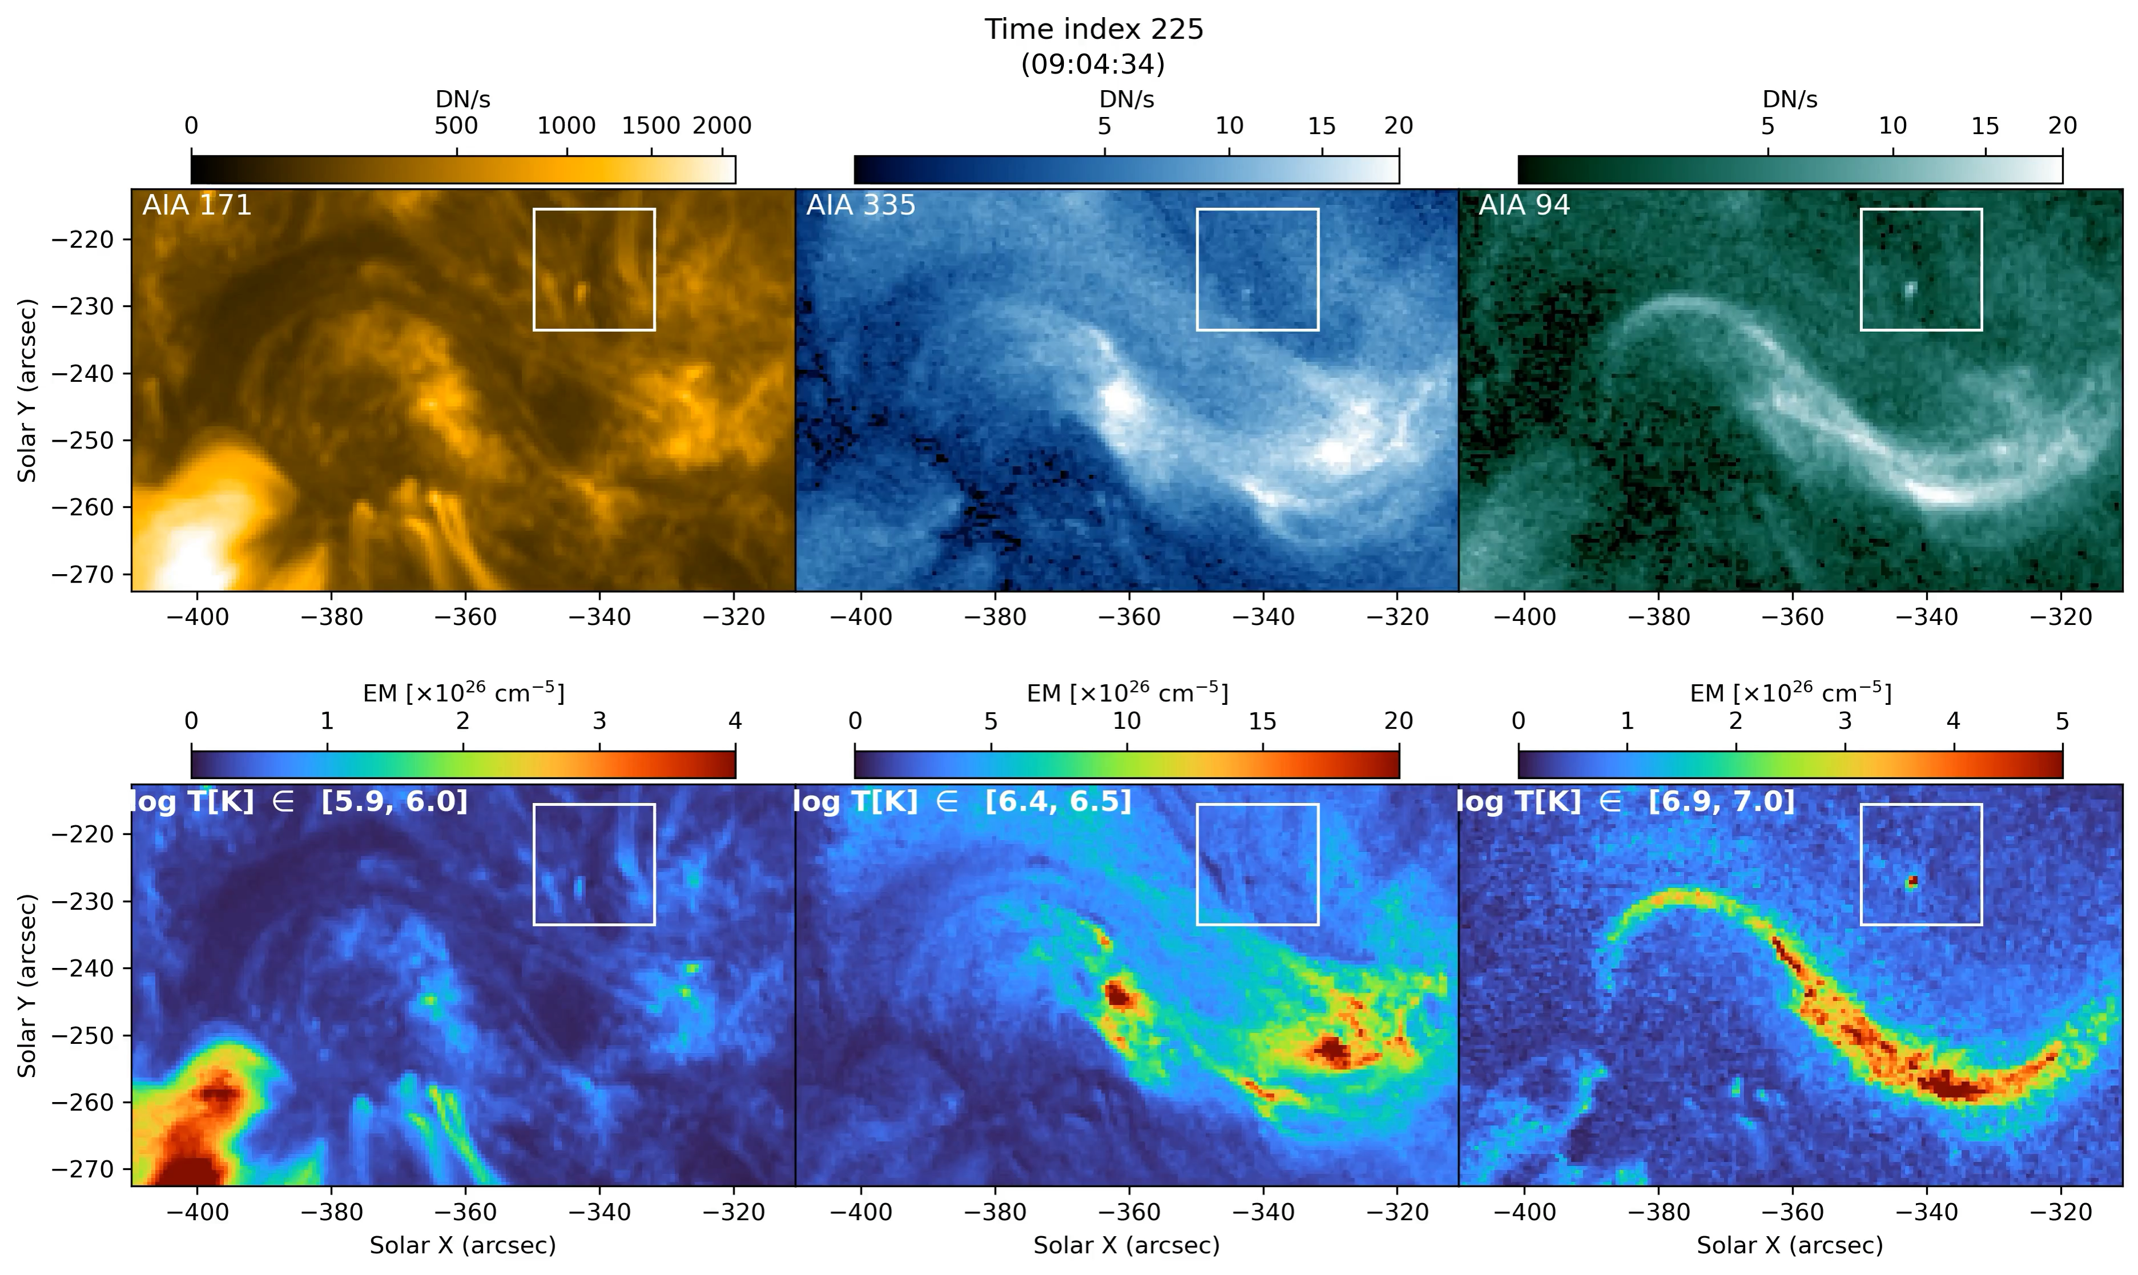
Extreme UV burst: multi-thermal plasma >1 MK

Slide 21
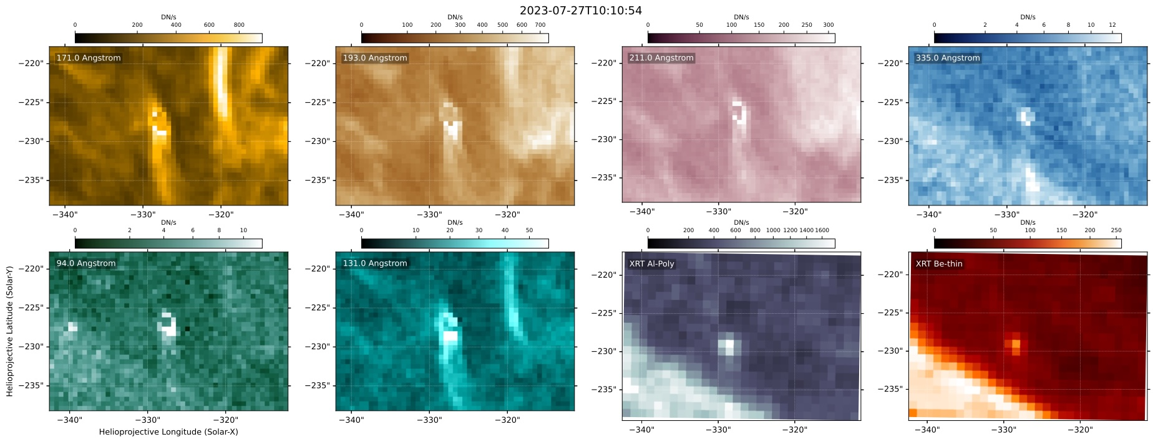
Extreme UV burst: multi-thermal plasma >1 MK
AIA 171Å
AIA 193Å
AIA 211Å
AIA 335Å
AIA 94Å
AIA 131Å
Hinode/XRT Al-Poly
Hinode/XRT Be-thin

Slide 22
Flux emergence is followed by a chain of events:
Ellerman bombs
UV burst
Dome structure
Plasmoids: blobs in H-beta and complex Si IV profiles
Surge activity
EUV burst and dome: multi-thermal plasma with >1 MK
Coordinated observations are required to unravel nature of energetic solar events
see Nóbrega-Siverio et al. 2024 A&A 686, 218 and Sand et al. 2026 arXiv

