Slide 1
Impact of small-scale photospheric magnetic reconnection events on the upper atmosphere
Luc Rouppe van der Voort
Rosseland Centre for Solar Physics (RoCS), University of Oslo
In collaboration with Jayant Joshi (IIA Bengaluru), Aditi Bhatnagar (RoCS Oslo) & Mats Ola Sand (RoCS Oslo)
ESPM-17 2024, Turin

Slide 2
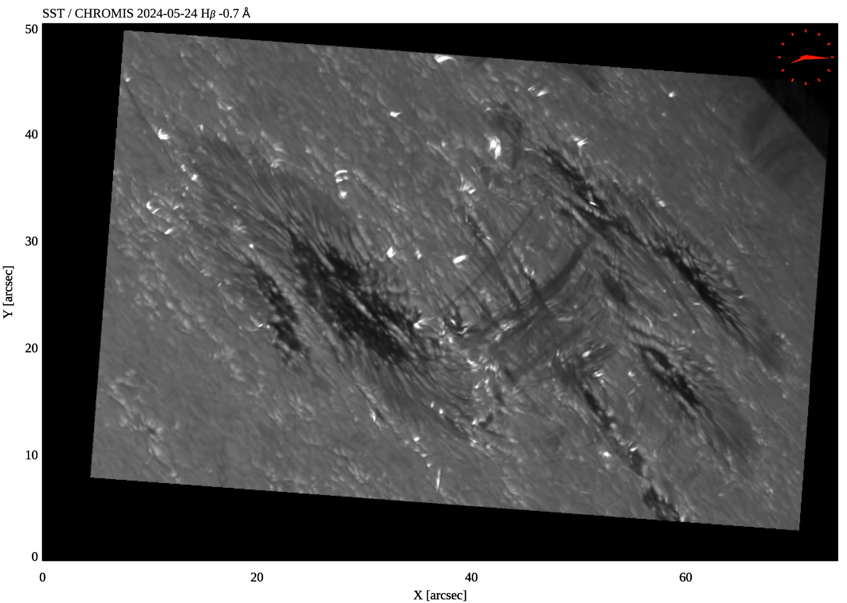
Ellerman bombs:
magnetic reconnection in low solar atmosphere
observers Reetika Joshi, Ignasi Soler Poquet & Avijeet Prasad

Slide 3
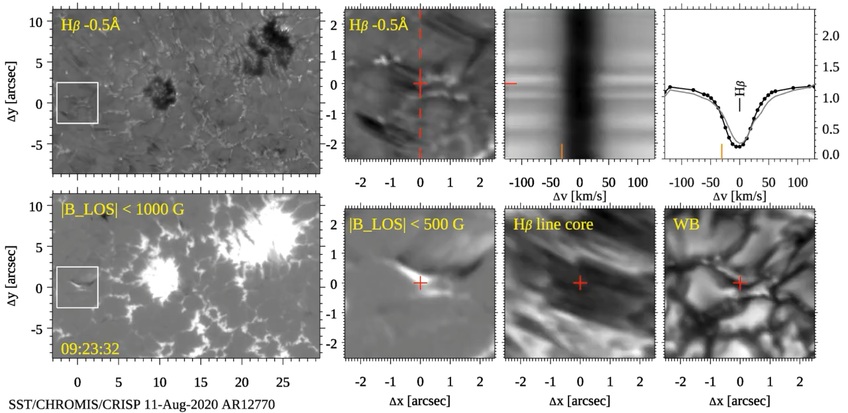
Ellerman bombs: magnetic reconnection in low solar atmosphere

Slide 4
Ellerman bombs: magnetic reconnection in low solar atmosphere

Slide 5
Ellerman bombs: magnetic reconnection in low solar atmosphere

Slide 6
Ellerman bombs: magnetic reconnection in low solar atmosphere

Slide 7
Ellerman bombs: magnetic reconnection in low solar atmosphere

Slide 8
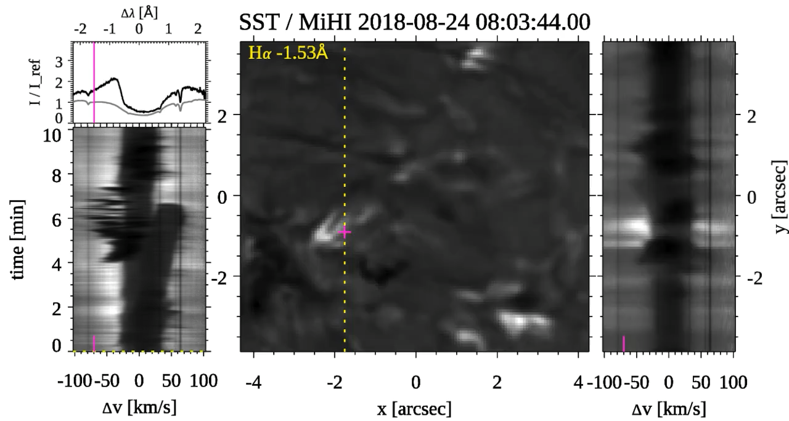
Unique observations of Ellerman bombs with MiHI instrument
H-alpha 6563 Å
8.6” x 7.7”
4.5 Å or ±102 km/s
1.33 s cadence
10 min duration
Rouppe van der Voort, van Noort & de la Cruz Rodriguez 2023 A&A 673, 11

Slide 9
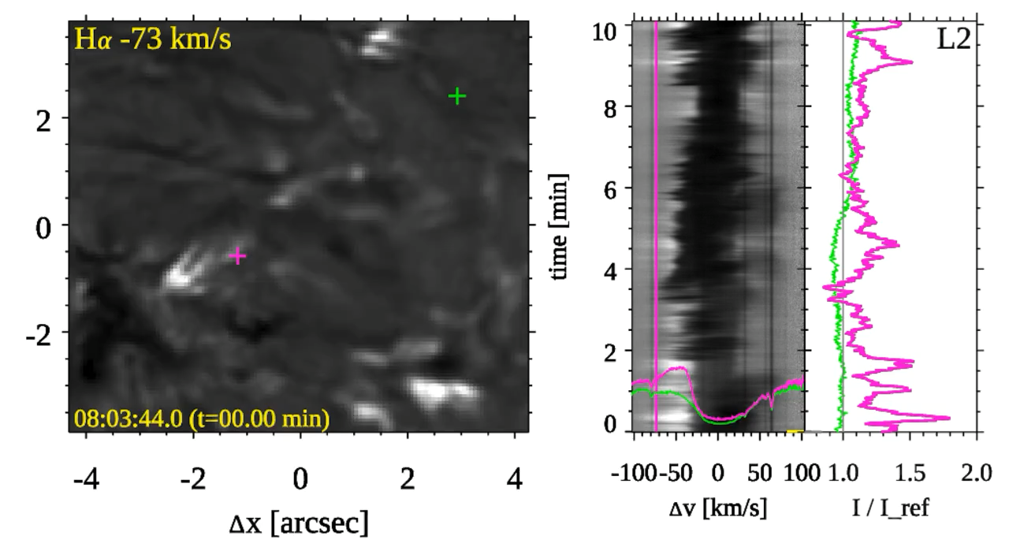
Plasmoid-like blobs emerging from Ellerman bombs: FWHM sizes 0.1 - 0.4”
Rouppe van der Voort, van Noort & de la Cruz Rodriguez 2023 A&A 673, 11

Slide 10
Ellerman bombs:
magnetic reconnection in low solar atmosphere
observers Reetika Joshi, Ignasi Soler Poquet & Avijeet Prasad

Slide 11
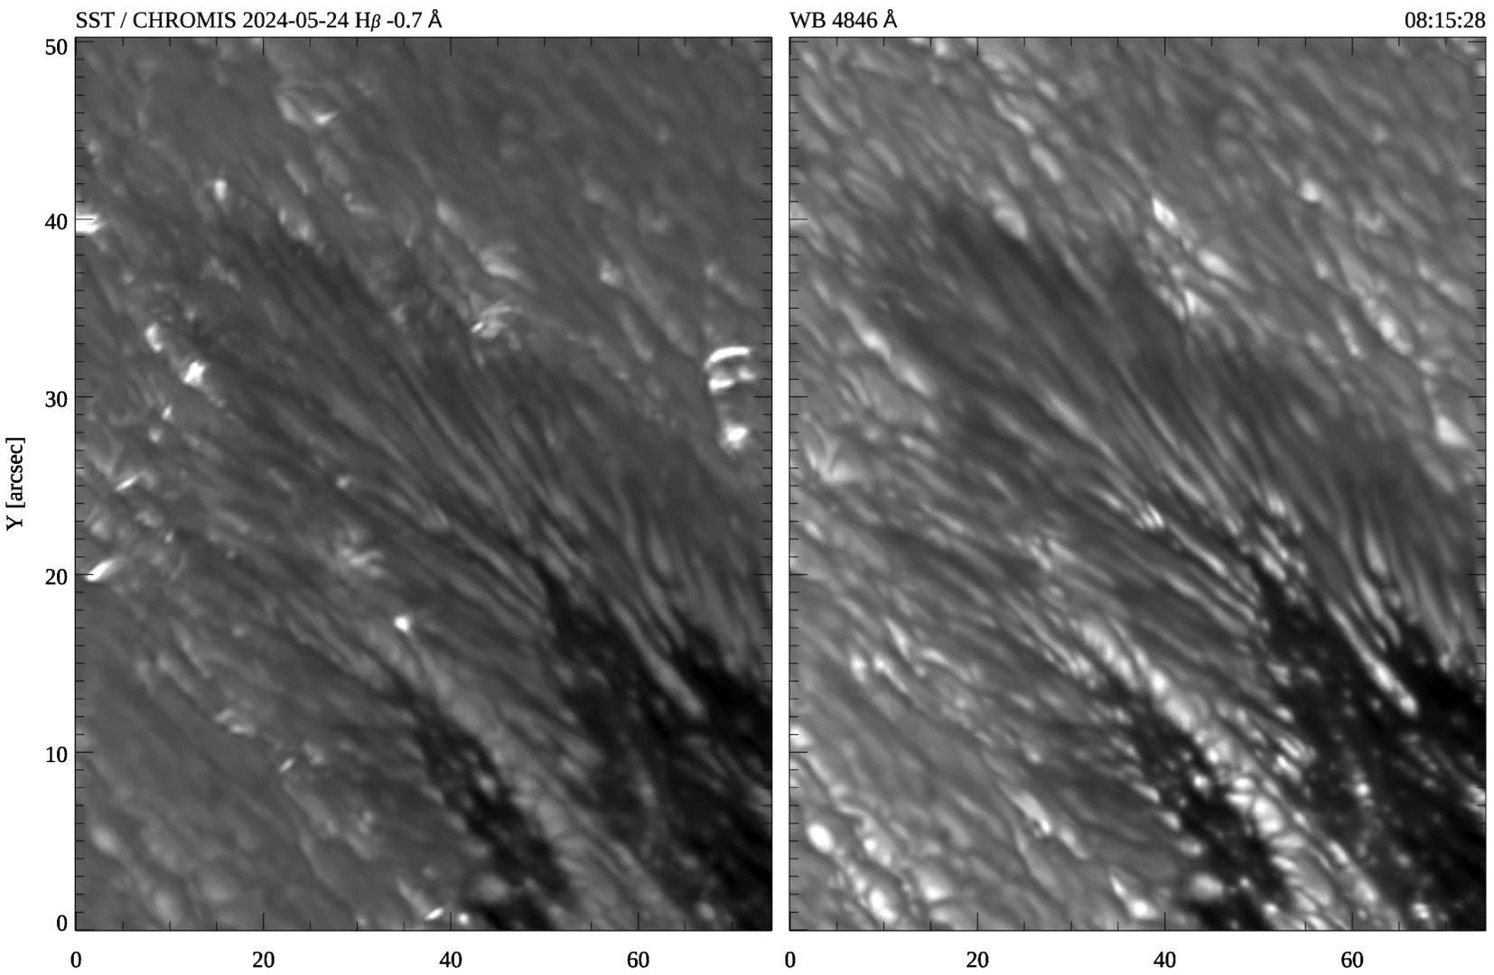
Ellerman bombs in the penumbra

Slide 12
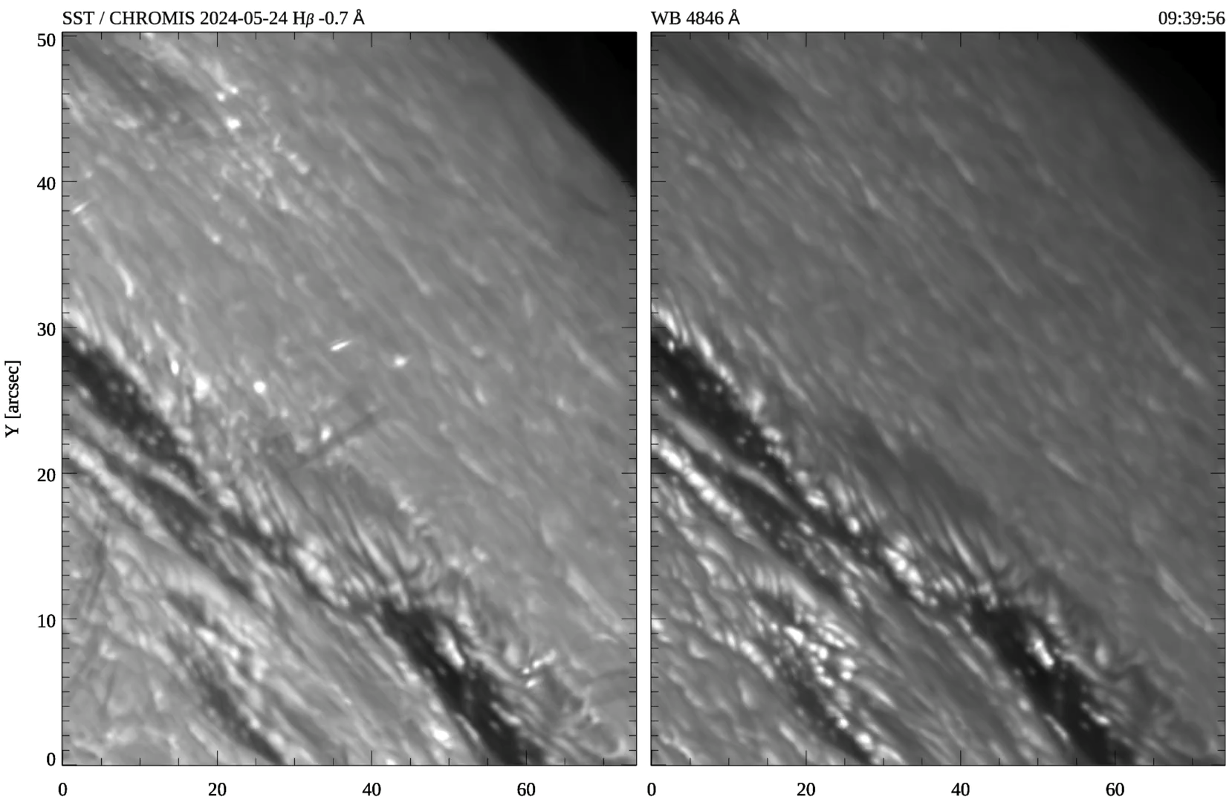
Ellerman bombs in the Quiet Sun

Slide 13
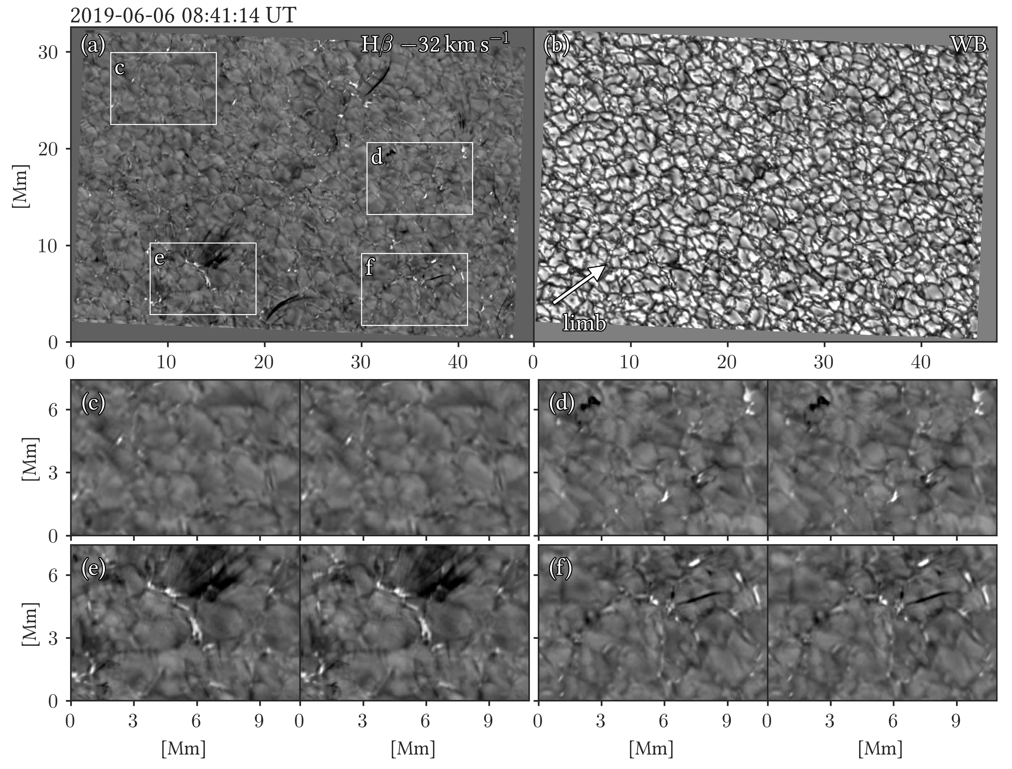
Large numbers of Ellerman bombs in quiet Sun:
>120 QSEBs
J. Joshi, Rouppe van der Voort & de la Cruz Rodríguez 2020 A&A Letters 641

Slide 14
Large numbers of Ellerman bombs in quiet Sun:
>120 QSEBs
→ >750,000 over whole Sun
J. Joshi, Rouppe van der Voort & de la Cruz Rodríguez 2020 A&A Letters 641

Slide 15
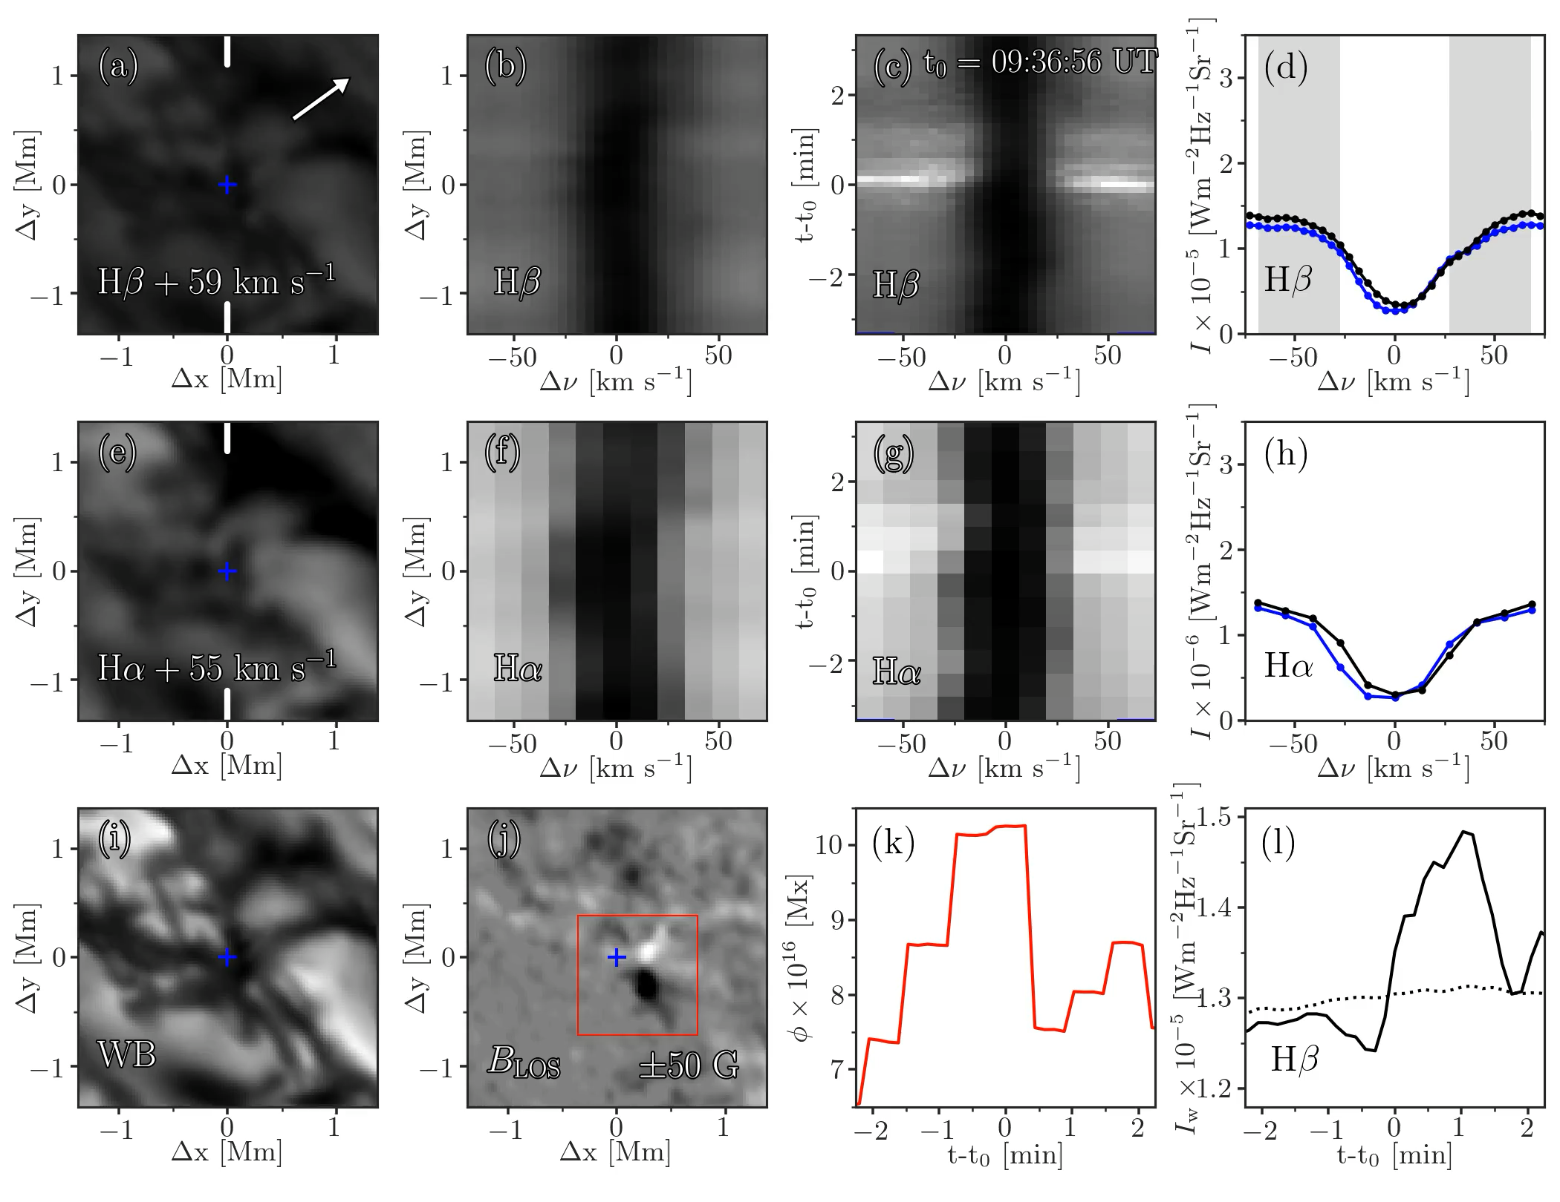
QSEB at μ=0.76
Flame, strong Hβ wing
J. Joshi, Rouppe van der Voort & de la Cruz Rodríguez 2020 A&A Letters 641

Slide 16
QSEB at μ=0.76
Flame, strong Hβ wing
Weak in Hα wing
Absent in WB cont
J. Joshi, Rouppe van der Voort & de la Cruz Rodríguez 2020 A&A Letters 641

Slide 17
QSEB at μ=0.76
Flame, strong Hβ wing
Weak in Hα wing
Absent in WB cont
Flux cancellation
J. Joshi, Rouppe van der Voort & de la Cruz Rodríguez 2020 A&A Letters 641

Slide 18
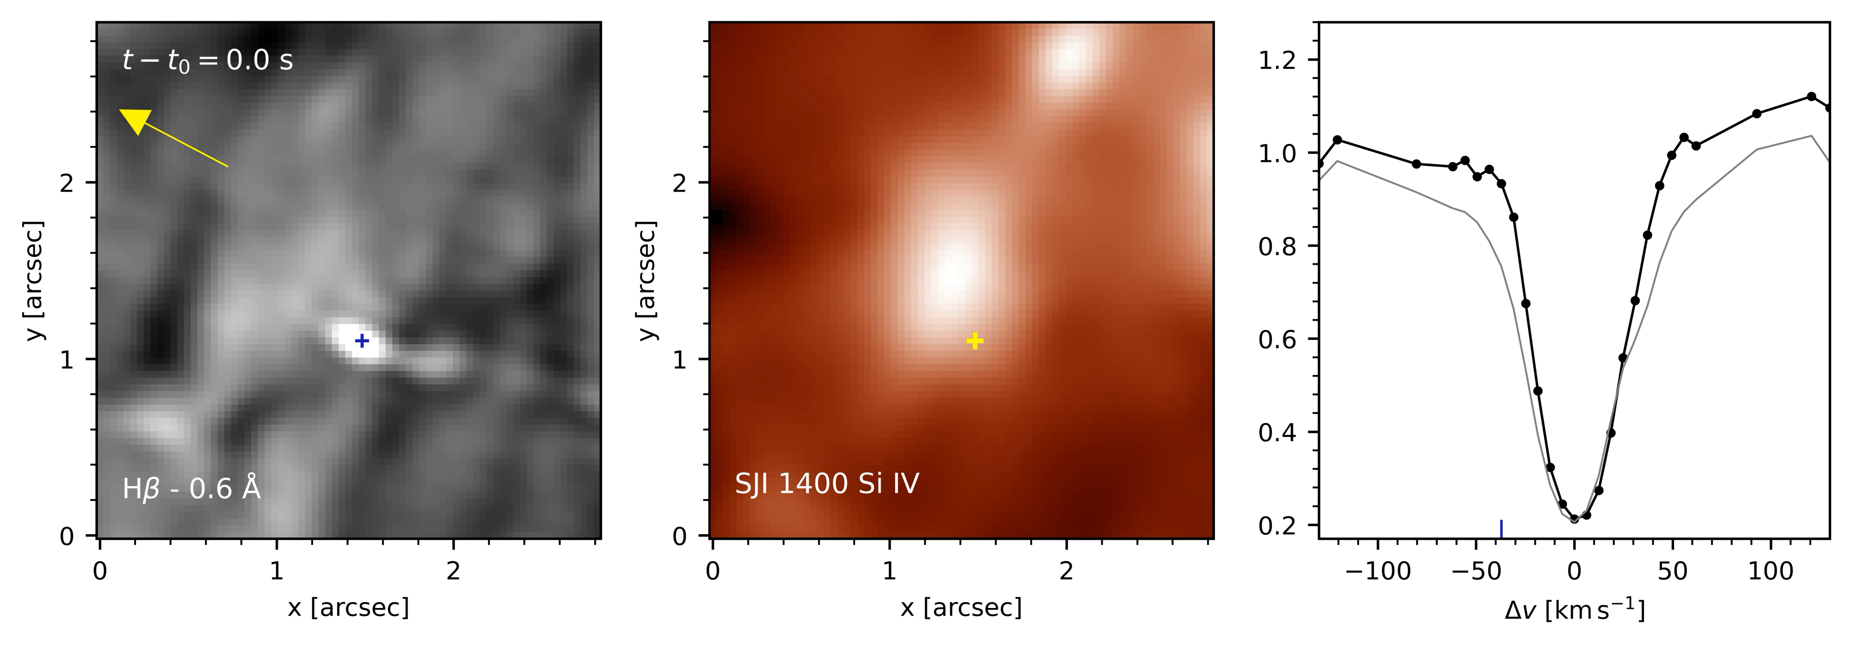
Impact of Quiet Sun Ellerman bombs on upper atmosphere?
IRIS
A. Bhatnagar et al. 2024 A&A in press / arXiv:2406.09585

Slide 19
Impact of Quiet Sun Ellerman bombs on upper atmosphere?
IRIS
Longer-lived QSEBs (> 1 min):
Some (15%) can be associated with brightenings in SJI 1400 and have Si IV 1394Å emission
→impact on overall atmosphere is limited
A. Bhatnagar et al. 2024 A&A in press / arXiv:2406.09585

Slide 20
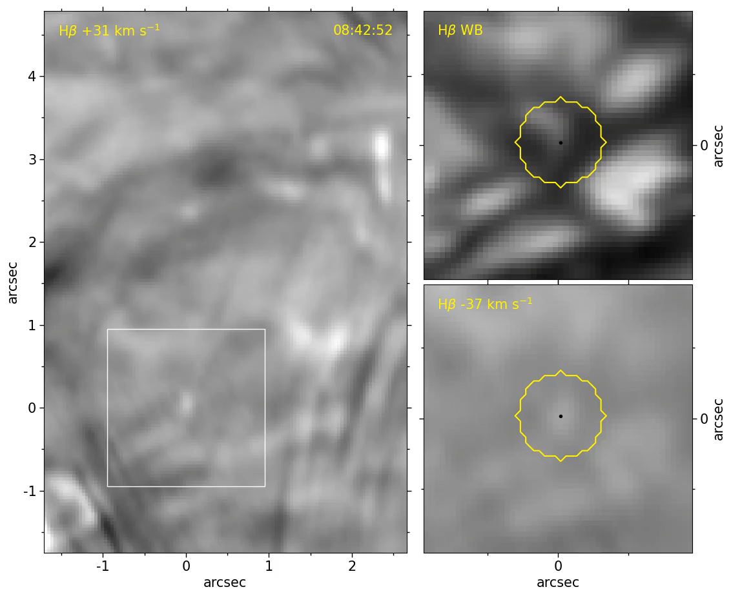
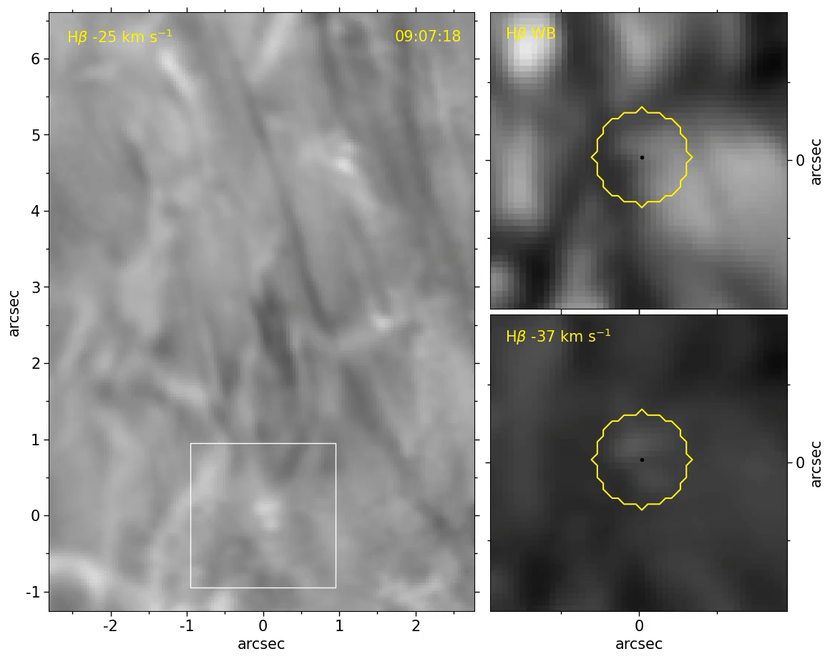
Connection between Quiet Sun Ellerman bombs and spicules?
Some suggestive cases of QSEBs with spicule activity
Movies courtesy of Mats Ola Sand
M.O. Sand et al. in prep

Slide 21
Connection between Quiet Sun Ellerman bombs and spicules?
Some suggestive cases of QSEBs with spicule activity
….but: majority of spicules have no QSEB….and majority of QSEBs have no spicules
Movies courtesy of Mats Ola Sand
M.O. Sand et al. in prep

Slide 22
Conclusions
Ellerman bombs can be found in many different environments: Active Region, sunspot penumbra, and Quiet Sun
Ellerman bombs in Quiet Sun are ubiquitous: >750,000 at any time
Impact on upper atmosphere is limited
Some have signatures in transition region diagnostics
Some seem to be associated with spicule activity

