Slide 1
Understanding Principal Compoent Analysis (PCA)
An intuitive introduction

Slide 2
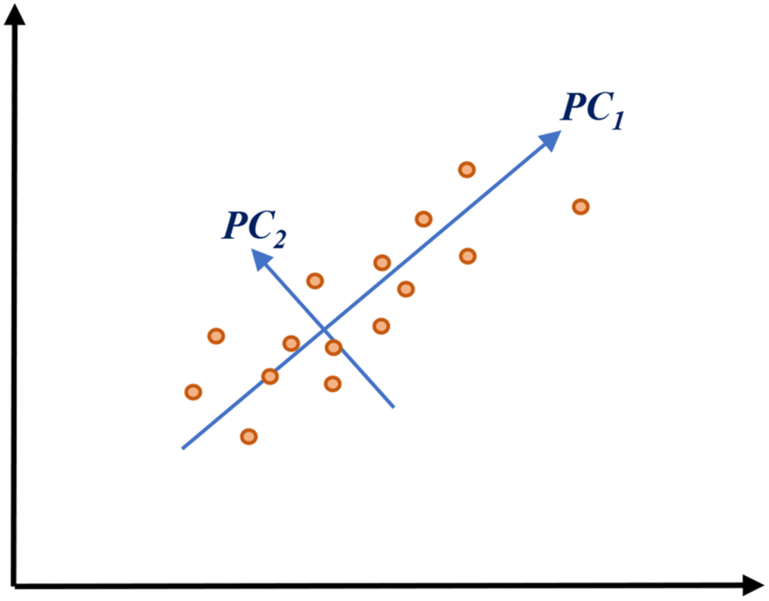
Traditional view of PCA
We have a (rectangular) data matrix containing $n$ samples of a set of $m$ features:$D=\left(\begin{matrix}d_{11} & ⋯ & d_{1m} \\ ⋮ & ⋱ & ⋮ \\ ⋮ & ⋱ & ⋮ \\ d_{n1} & ⋯ & d_{nm}\end{matrix}\right).$
Principal components, $v_{i}$, are the combinations
of features explaining most of the variance
between the rows of this matrix.
$v_{i}$ are the leading eigenvectors of the cov. matrix, $C=D^{T}D$
We define PCA amplitudes by taking dot with each row:$a_{i}=Dv_{i}$, these say how much of each principal component is present in each sample/row.

Slide 3
A different view
What if we want to approximate the matrix $D$by the “closest” possible rank-1matrix:
$$D=\left(\begin{matrix}d_{11} & ⋯ & d_{1m} \\ ⋮ & ⋱ & ⋮ \\ ⋮ & ⋱ & ⋮ \\ d_{n1} & ⋯ & d_{nm}\end{matrix}\right)≈\left(\begin{matrix}⋮ \\ u \\ ⋮\end{matrix}\right)\left(\begin{matrix}⋯ & v & ⋯\end{matrix}\right)$$
Or by the sum of $k$ rank one matrices:
$D≈σ_{0}\left(\begin{matrix}⋮ \\ \hat{u_{0}} \\ ⋮\end{matrix}\right)\left(\begin{matrix}⋯ & \hat{v_{0}} & ⋯\end{matrix}\right)$ ${+⋯+σ}_{k}\left(\begin{matrix}⋮ \\ \hat{u_{k}} \\ ⋮\end{matrix}\right)\left(\begin{matrix}⋯ & \hat{v_{k}} & ⋯\end{matrix}\right)$,
where $σ_{0}>σ_{1}>⋯>σ_{k}$.
This is equivalent to PCA (*) with pricipal components $\hat{v_{i}}$and amplitudes $a_{i}=σ_{i}\hat{{ u}_{i}}$. Note that in this formulation the principal components and amplitudes are basically equivalent, and if we started with $D^{T}$, then $\hat{{ u}_{i}}$and $\hat{{ v}_{i}}$would switch.

Slide 4
A different view (using the SVD)
We can decompose the matrix $D$using the SVD:
$D=UΣV^{T}$, where $Σ$ has the singular values of $D$, $σ_{i}$, on the diagonal.
The columns of $U$ and $V$ are the left and right singular vectors of $D$, satisfying $Dv_{i}= σ_{i}u_{i}, D^{T}u_{i}= σ_{i}v_{i}$.
If we sort the singular vectors by the size of the singular values, we can approximate the matrix $D$, by choosing the first few vectors:
$D≈ {\sum_{i}{u_{i}}σ}_{i}$ $v_{i}^{T}$, which is the expansion in terms of rank-1 matrices we wanted, and is eqivalent to the PCA with pricipal components $v_{i}$ and amplitudes $a_{i}={σ_{i}u}_{i}$.

Slide 5
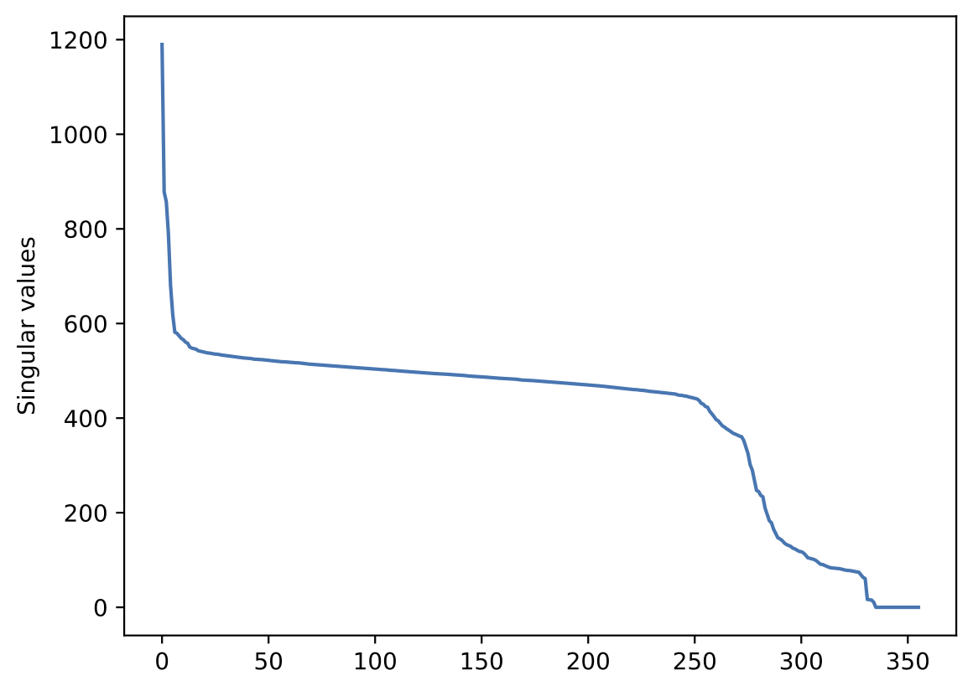
How many components/modes to use?
Typical singular value spectrum:
Signal part
Noise part
Suppressed/null-modes
PCA only really useful for the signal part

Slide 6
All-feed PCA (in l2gen)
The all-feed PCA filter takes in the (poly/continuum) time-ordered data from all feeds and does a joint PCA analysis. Great at picking up standing waves that are common to multiple feeds.
$m=n_{time}≈10000−20000$
$n=n_{freq}∙n_{sb}$ $∙n_{feed}=1024$ $∙$4 $∙$19

Slide 7
Map-level PCA
The map-level PCA takes a single 3D-feed map and does a PCA analysis on it.
$m=n_{pix, x} ∙n_{pix,y}=120 ∙120$
$n=n_{freq}=256$

Slide 8
Az-freq binning PCA
Here the filtered time-ordered (level2) data from each feed is binned in az or daz/dt and frequency, we then do a PCA analysis of this 2D matrix for each feed.
$m=n_{az}=1\text{00}$
$n=n_{freq}=256$

Slide 9
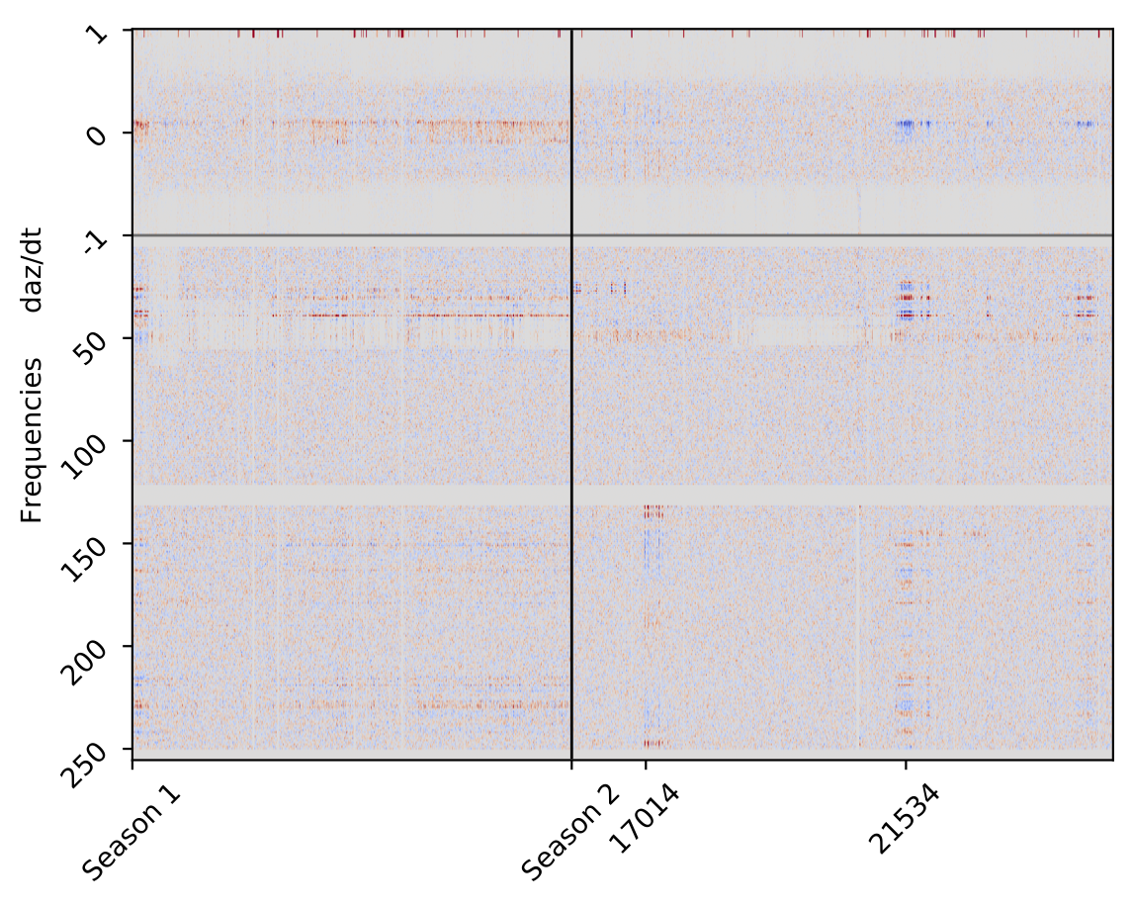
Az-freq meta PCA
Here we use the first few PCA modes from the Az-freq binning PCA for each scan and combine the data from all scans into a (huge) matrix:
$m=n_{az} +n_{freq}=100 ∙256$
$n=n_{modes}∙n_{scan}≈5∙30000$

