Slide 1
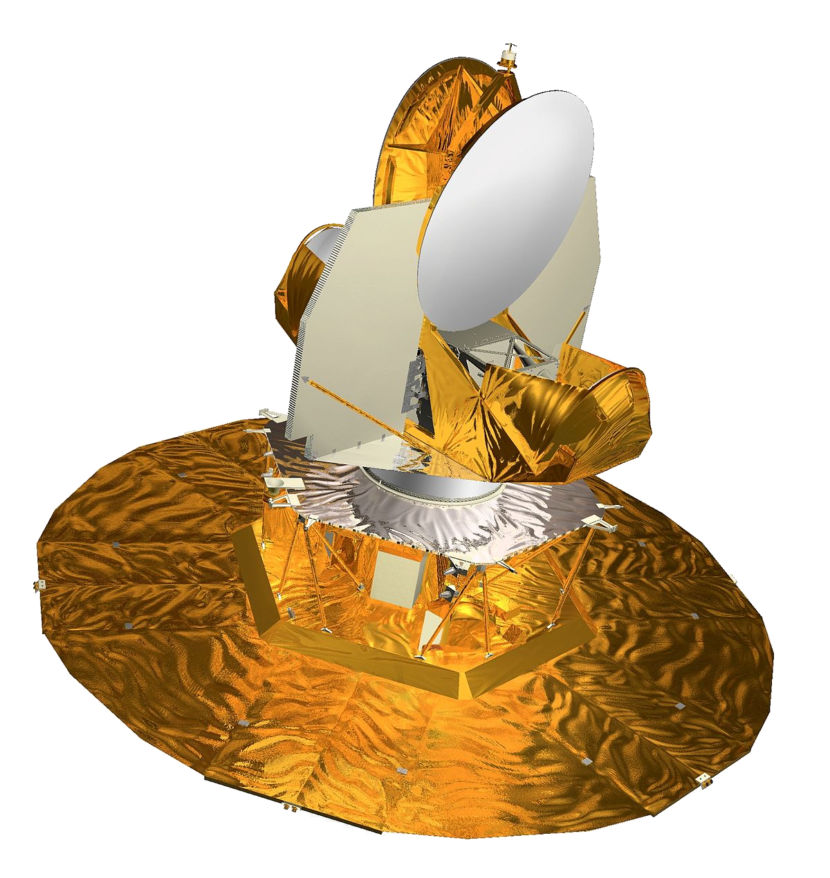
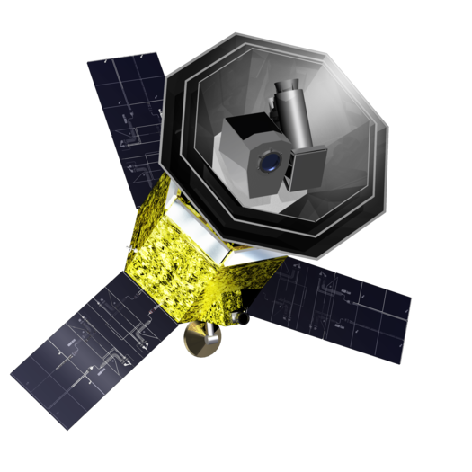
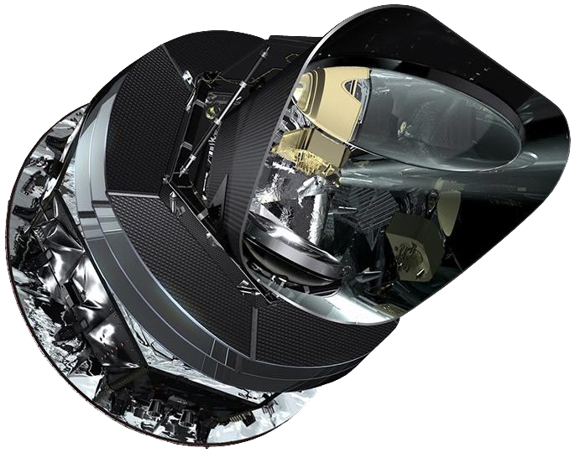
Noise characterization and modelling
Håvard Tveit Ihle
BeyondPlanck online release conference, November 18-20, 2020
This project has received funding from the European Union’s Horizon 2020 research and innovation programme under grant agreement No 776282
Notes:
Online Template: https://goo.gl/1Ke3DH

Slide 2
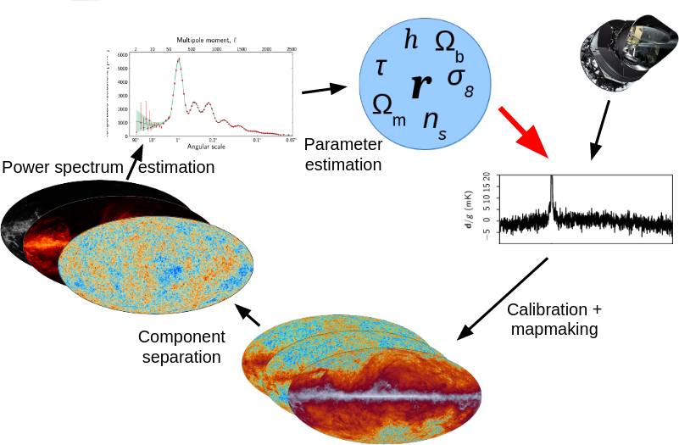
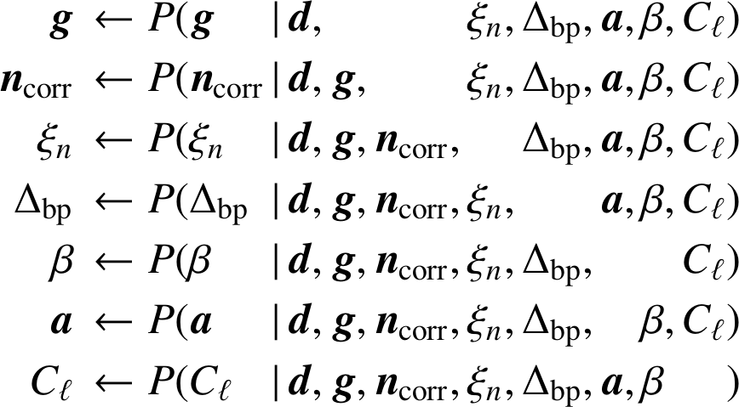
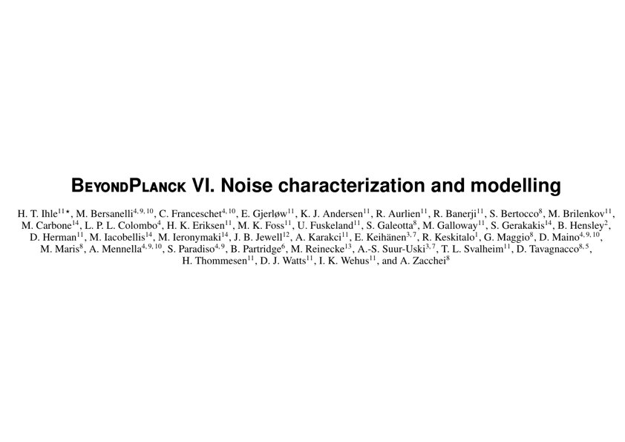
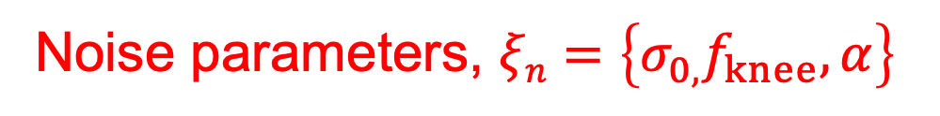

The BeyondPlanck Gibbs sampler
Correlated noise, $n^{corr}$
What we want to do:
How we actually do it:
Noise parameters, $ξn=\left\{σ_{0,}f_{knee},α\right\}$
arXiv:2011.06650

Slide 3
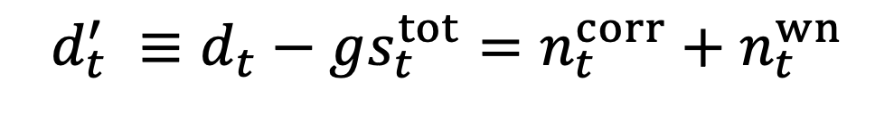
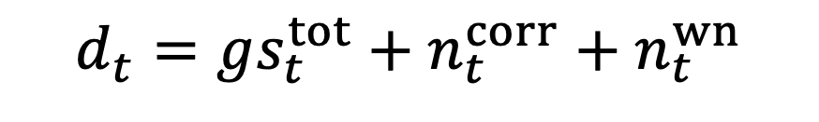
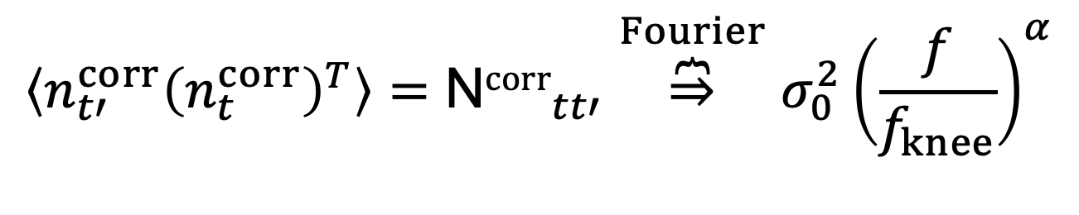
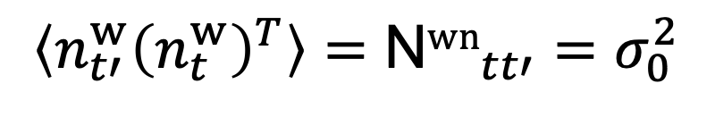
Data model
$$d_{t}=gs_{t}^{tot}+n_{t}^{corr}+n_{t}^{wn}$$
Signal subtracted data:
$$d_{t}^{′} ≡d_{t}−gs_{t}^{tot}=n_{t}^{corr}+n_{t}^{wn}$$
Covariance matrices:
$$\left\langle n_{t′}^{w}{\left(n_{t}^{w}\right)}^{T}\right\rangle ={\text{N}wn}_{tt′}=σ_{0}^{2}$$
$$\left\langle n_{t′}^{corr}{\left(n_{t}^{corr}\right)}^{T}\right\rangle ={\text{N}corr}_{tt′}\overset{Fourier}{\overbrace{⇒}}σ_{0}^{2}{\left(\frac{f}{f_{knee}}\right)}^{α}$$

Slide 4




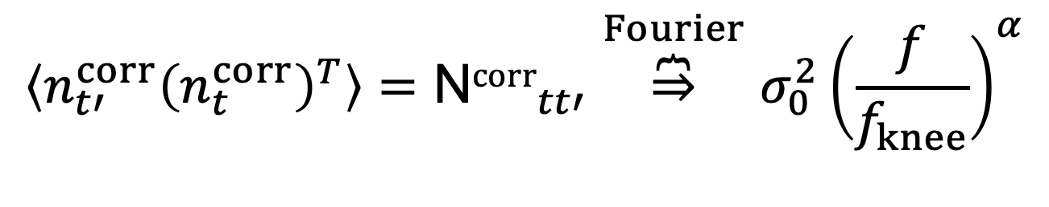
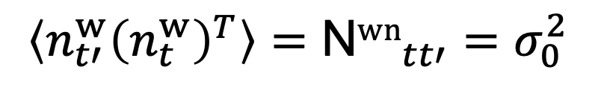
1/$f −model$
$$α$$
$$f_{knee}$$
$$σ_{0}^{2}$$
$$\left\langle n_{t′}^{w}{\left(n_{t}^{w}\right)}^{T}\right\rangle ={\text{N}wn}_{tt′}=σ_{0}^{2}$$
$$\left\langle n_{t′}^{corr}{\left(n_{t}^{corr}\right)}^{T}\right\rangle ={\text{N}corr}_{tt′}\overset{Fourier}{\overbrace{⇒}}σ_{0}^{2}{\left(\frac{f}{f_{knee}}\right)}^{α}$$

Slide 5




Sampling the correlated noise
$$\left({\text{N}}_{wn}^{−1}+{\text{N}}_{corr}^{−1}\right)n^{corr}={\text{N}}_{wn}^{−1}d′+{\text{N}}_{wn}^{−1/2}w_{1}+{\text{N}}_{corr}^{−1/2}w_{2}$$
$$w_{i}∼\text{N}\left(0,σ\right)$$
Maximum Likelihood
Sampling terms
Solve in Fourier space:
$$n_{f}^{corr}=\frac{d_{f}^{′}+{\text{N}}_{wn}^{1/2}w_{1}+{{\text{N}}_{wn}\text{N}}_{corr}^{−1/2}w_{2}}{1+{\text{N}}_{wn}/{\text{N}}_{corr}}$$
Masked data

Slide 6

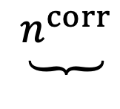
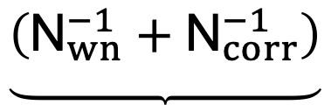
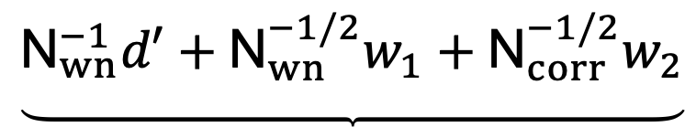
Sampling the correlated noise
$$\underbrace{\left({\text{N}}_{wn}^{−1}+{\text{N}}_{corr}^{−1}\right)}$$
$$\underbrace{n^{corr}}$$
$$=$$
$$\underbrace{{\text{N}}_{wn}^{−1}d′+{\text{N}}_{wn}^{−1/2}w_{1}+{\text{N}}_{corr}^{−1/2}w_{2}}$$
A
x
=
b
Solve by iterative conjugate gradient (CG) method:
Costly, but doable, in terms of CPU-time!
(See Keihänen et. al. (2020) for details)
(See Galloway et. al. (2020) for details)

Slide 8
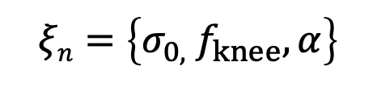
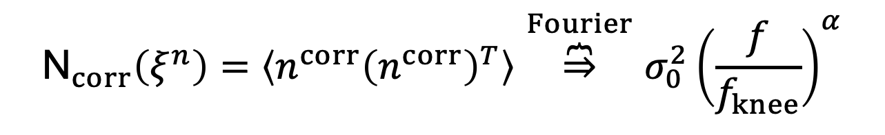
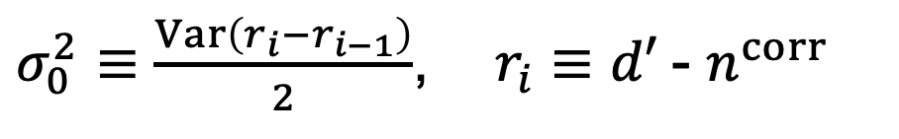
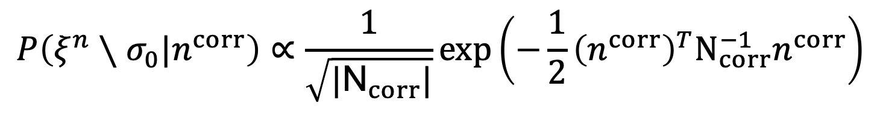


Noise power spectrum sampling
$$ξn=\left\{σ_{0,}{ f}_{knee},α\right\}$$
Need to sample noise PSD parameters (
)
(Sampled independently for each ~ 1 hour pointing period (PID))
We use the following trick to fix
$$σ_{0}$$
$$σ_{0}$$
(so is not sampled!)
$σ_{0}^{2}≡\frac{Var\left(r_{i}−r_{i−1}\right)}{2}$, ${ r}_{i}$ $≡$ $d′$- $n^{corr}$
For the correlated noise parameters we sample from the likelihood
$$P\left(ξ^{n}∖σ_{0}|n^{corr}\right)∝\frac{1}{\sqrt{|{\text{N}}_{corr}|}}exp\left(−\frac{1}{2}{\left(n^{corr}\right)}^{T}N_{corr}^{−1}n^{corr}\right)$$
where
$${\text{N}}_{corr}\left(ξ^{n}\right)=\left\langle n^{corr}{\left(n^{corr}\right)}^{T}\right\rangle \overset{Fourier}{\overbrace{⇒}}σ_{0}^{2}{\left(\frac{f}{f_{knee}}\right)}^{α}$$

Slide 9
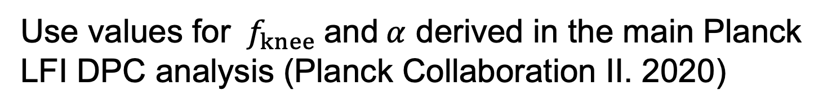

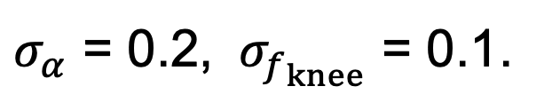
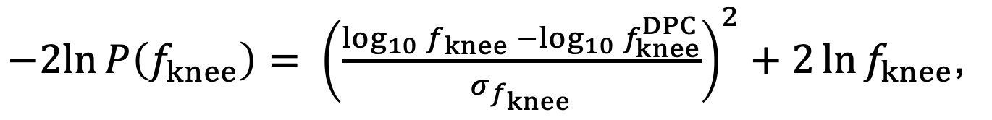
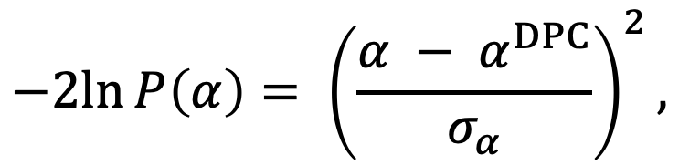
Priors on ${ f}_{knee} \text{and} α$
Use values for ${ f}_{knee} \text{and} α$ derived in the main Planck LFI DPC analysis (Planck Collaboration II. 2020)
$$−2ln{P\left(α\right)= {\left(\frac{α − α^{DPC}}{σ_{α}}\right)}^{2},}$$
$−2ln{P\left(f_{knee}\right)= {\left(\frac{\log_{10}{f_{knee}} −\log_{10}{f_{knee}^{DPC}}}{σ_{f_{knee}}}\right)}^{2}+2\ln{f_{knee}}}$,
$σ_{α}$ = 0.2, ${ σ}_{f_{knee}}$ = 0.1.

Slide 10
Example of full noise model

Slide 11

Correlated noise maps (one Gibbs sample)
30 GHz
44 GHz
70 GHz
Gjerløw et. al. 2020

Slide 12
Evolution of noise parameters
70 GHz, 20M

Slide 13
Evolution of noise parameters

Slide 14
Evolution of noise parameters
70 GHz, 21S

Slide 15
Evolution of noise parameters
70 GHz, 19M

Slide 16
Inter-radiometer correlations of noise parameters

Slide 17
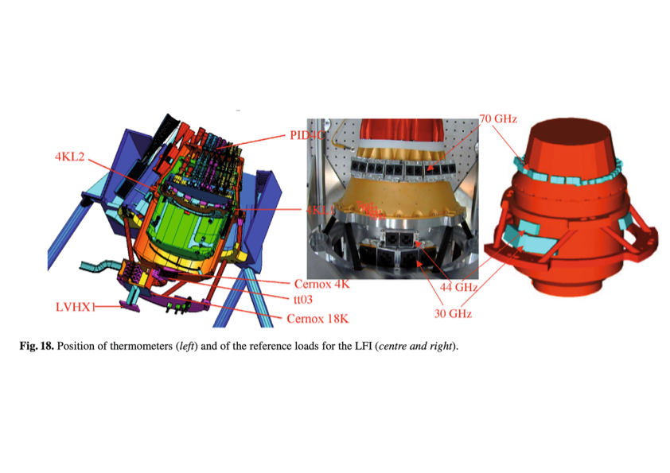
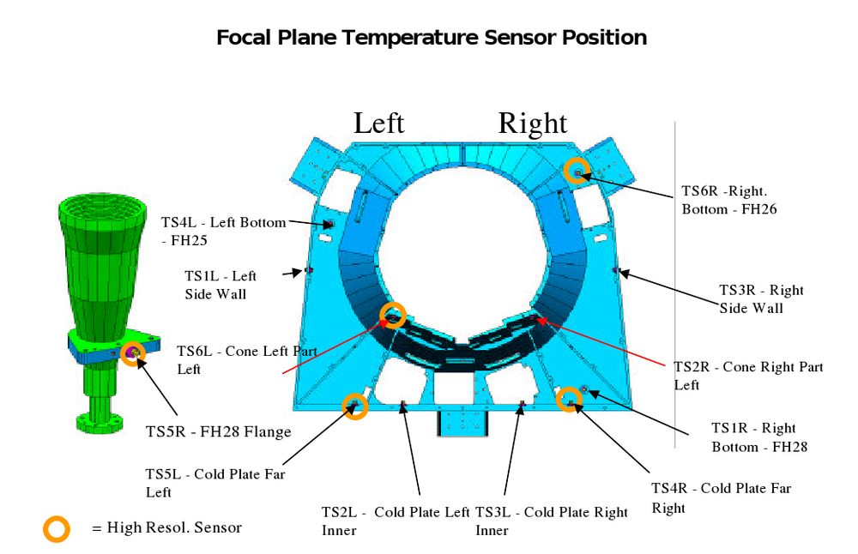
Temperature sensors on the Planck Instrument
(Lamarre et. al. 2010)
(Bersanelli et.al. 2010)

Slide 18
Relating temperature sensors to noise properties
70 GHz, average

Slide 19
Inter-radiometer correlation of the correlated noise?
PID: 12301

Slide 20
Inter-radiometer correlation of the correlated noise

Slide 21
Inter-radiometer correlation of the correlated noise
70 GHz
Pointing period (PID) 12301

Slide 22
Evolution of noise parameters
44 GHz, 25M

Slide 23
Evolution of noise parameters
30 GHz, 28M

Slide 24
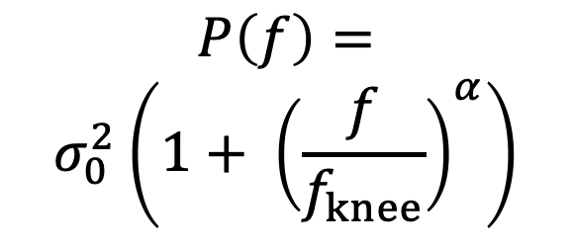


Limits of the 1$/f$ model?
$$P\left(f\right)=$$
$$σ_{0}^{2}\left(1+ {\left(\frac{f}{f_{knee}}\right)}^{α}\right)$$
Temporal frequencies 0.1 - 5 Hz,
corresponds roughly to angular scales
of 1-60 degrees. Our main science range!

Slide 25
Limits of the 1$/f$ model?
$$P\left(f\right)=$$
$$σ_{0}^{2}\left(1+ {\left(\frac{f}{f_{knee}}\right)}^{α}\right)$$
Not used!

Slide 26
Summary
Gap – filling using CG is costly, but works great for correlated noise sampling
Noise properties change significantly over time as the LFI thermal environment changes
At times large correlations between the noise of the different radiometers (mostly on long timescales)
Residual issues for 30 and 44 GHz. Breakdown of
1/f - model?

Slide 27

Funding
This project has received funding from the European Union’s Horizon 2020 research and innovation programme under grant agreement No 776282
“BeyondPlanck”
  COMPET-4 program
  PI: Hans Kristian Eriksen
  Grant no.: 776282
  Period: Mar 2018 to Nov 2020
Collaborating projects:
“bits2cosmology”
  ERC Consolidator Grant
  PI: Hans Kristian Eriksen
  Grant no: 772 253
  Period: April 2018 to March 2023
“Cosmoglobe”
  ERC Consolidator Grant
  PI: Ingunn Wehus
  Grant no: 819 478
  Period: June 2019 to May 2024

Slide 28














Questions?

