Slide 1
COMAP Data, Systematics and Analysis Pipeline
Håvard Tveit Ihle, University of Oslo, 22. Nov 2021

Slide 2
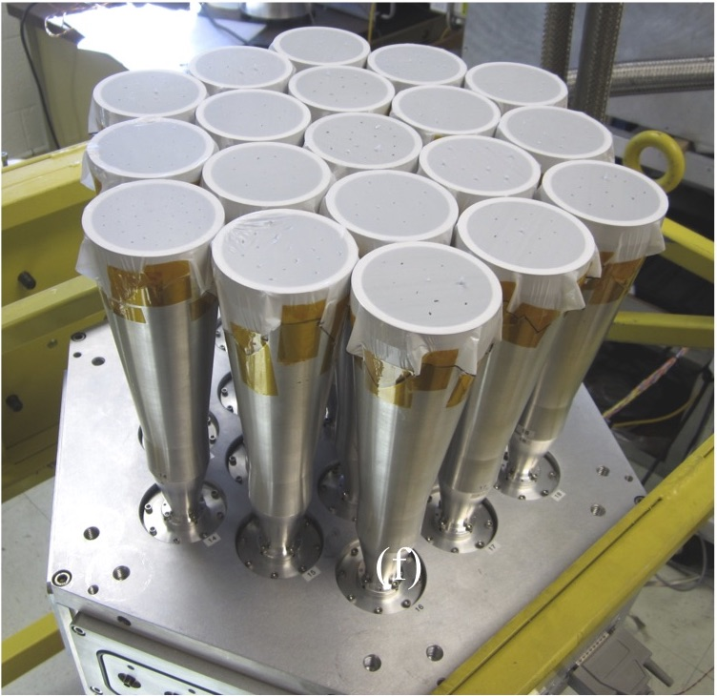
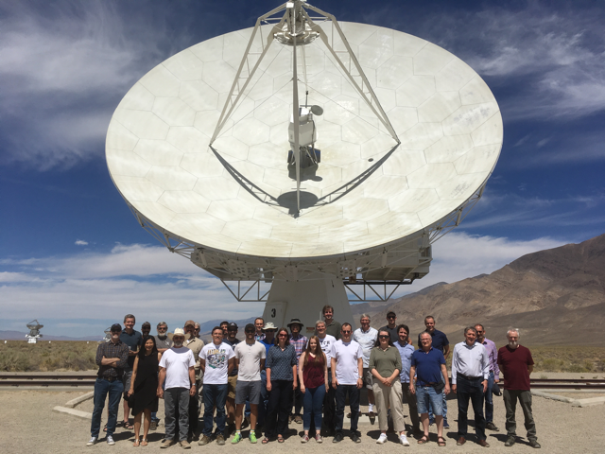








COMAP
Intensity mapping experiment targeting CO
CO traces star formation/large scale structure
International collaboration
Oslo team responsible for data analysis
Credit: K. Cleary

Slide 3
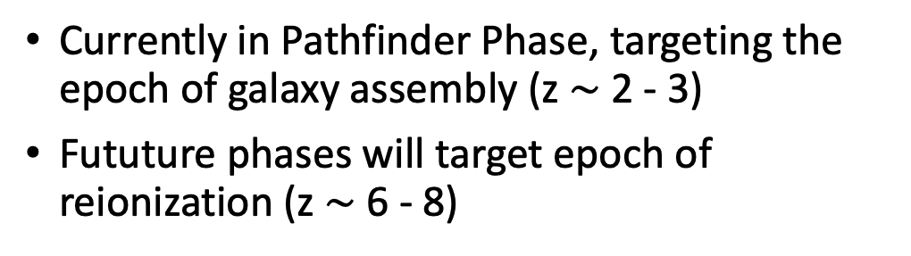
The future of COMAP
Currently in Pathfinder Phase, targeting the epoch of galaxy assembly (z $\sim$ 2 - 3)
Fututure phases will target epoch of reionization (z $\sim$ 6 - 8)
Credit: K. Cleary
Credit: K. Cleary

Slide 4
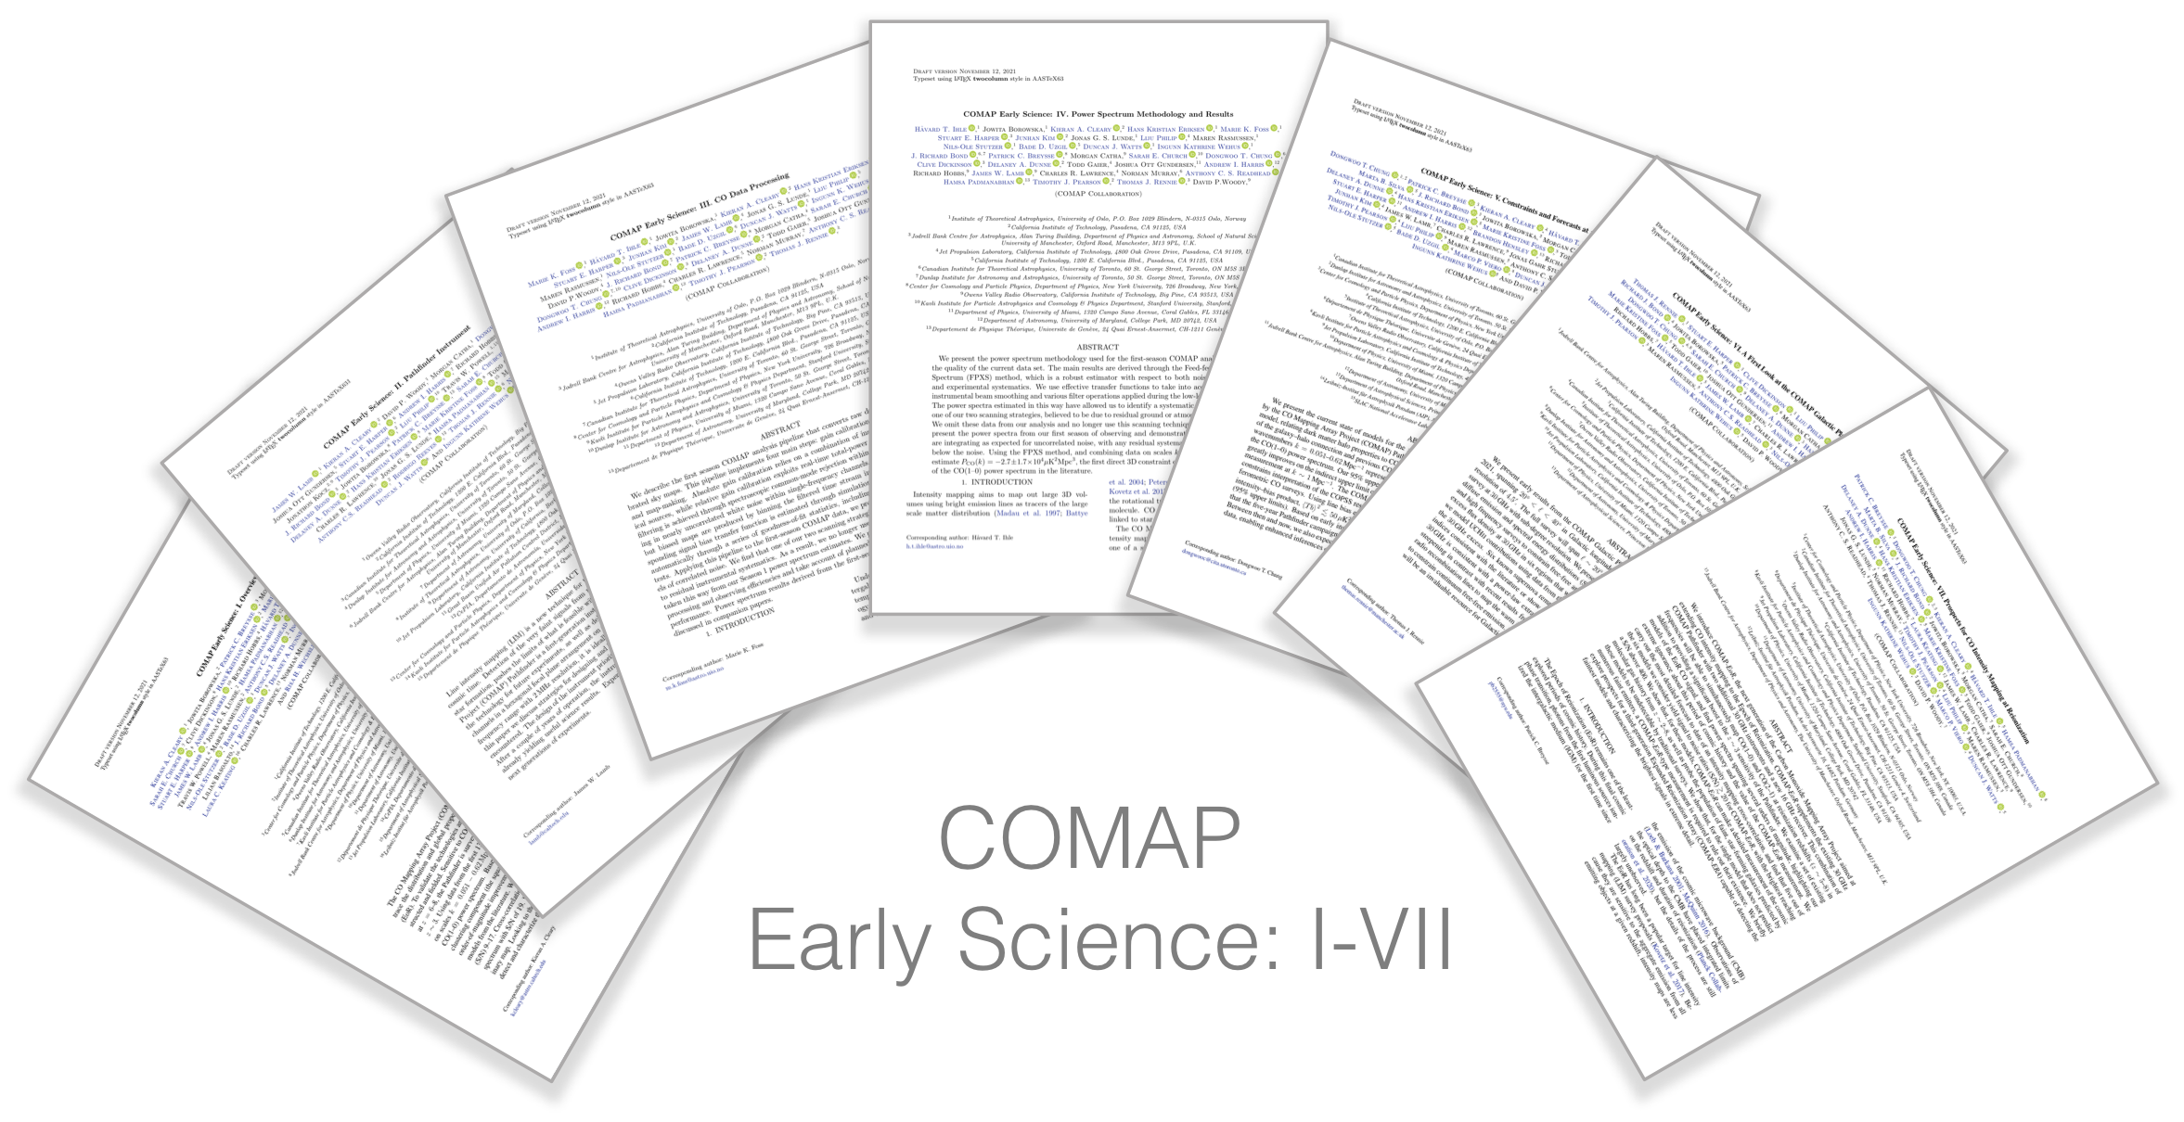

Slide 5
COMAP data
Good data
Data divided into ”scans” of 3-10 minutes each, centered on same point in Az/El
Each scan analysed independently.
Bad weather
Spikes
Credit: J. S. Lunde

Slide 6



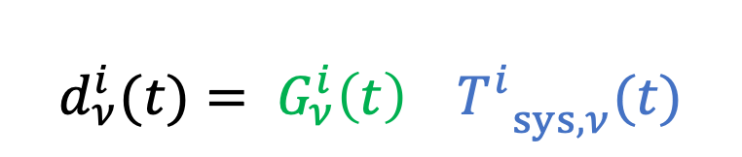

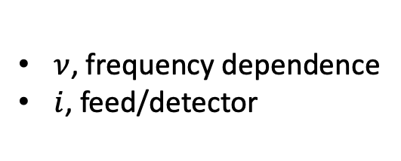
Data model
Measured power is given by gain times system temperature
$$d_{ν}^{i}(t)= G_{ν}^{i}{\left(t\right){ T}^{i}}_{sys,ν}(t)$$
$=\left\langle { G}_{ν}^{i}(t)\right\rangle \left(1+ n_{corr}^{G, i}(t)\right)$ $\left\langle {T^{i}}_{sys,ν}(t)\right\rangle$ $\left(1+A∆τ\left(El\right)+ Δs_{cont}+Δs_{gnd}+ n_{corr,ν}^{SW}\left(t\right)+n_{corr}^{atm}\left(t\right)+n_{w}^{ν,i}(t)\right)$
$$≈\left\langle { G}_{ν}^{i}(t)\right\rangle \left\langle {T^{i}}_{sys,ν}(t)\right\rangle \left(1+A∆τ\left(El\right)+ Δs_{cont}+Δs_{gnd}+n_{corr}^{G, i}\left(t\right)+n_{corr,ν}^{SW}\left(t\right)+n_{corr}^{atm}\left(t\right)+n_{w}^{ν,i}(t)\right)$$
$ν$, frequency dependence
$i$, feed/detector
Continnum sources
Correlated noise

Slide 7
Correlation plot
Correlation between the data of different feeds (detectors)
Very useful statistic for understanding the data and detecting systematics

Slide 8
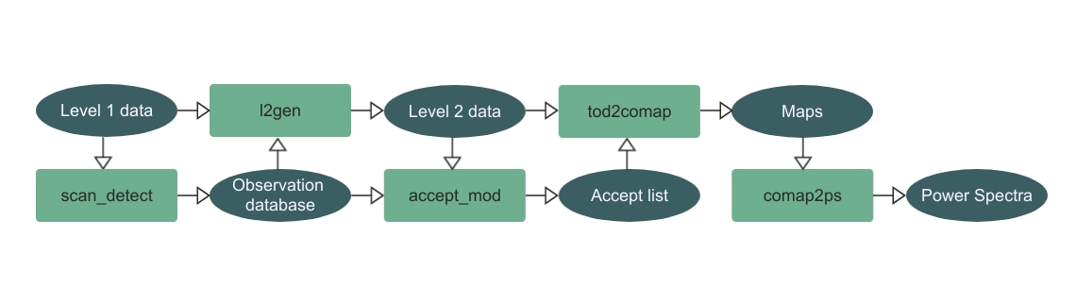
Low level data analysis
Use several filtering steps to remove systematics and correlated noise
Calibrate and prepare the data for mapmaking
Credit: J. S. Lunde
Credit: J. S. Lunde

Slide 9
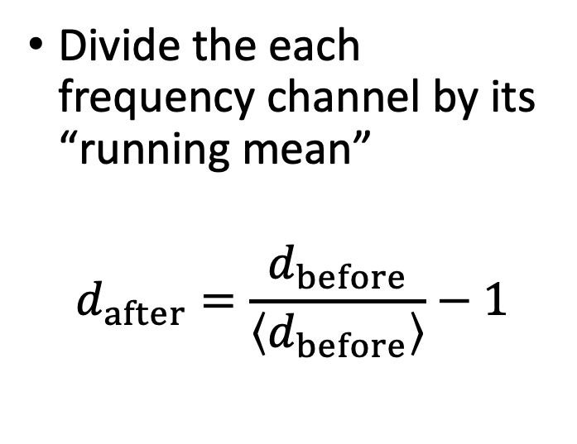



Normalization
Divide the each frequency channel by its “running mean”
$$d_{after}=\frac{d_{before}}{\left\langle d_{before}\right\rangle }−1$$
$$d_{after}≈\left\langle { G}_{ν}^{i}(t)\right\rangle \left\langle {T^{i}}_{sys,ν}(t)\right\rangle \left(1+A∆τ\left(El\right)+ Δs_{cont}+Δs_{gnd}+n_{corr}^{G, i}\left(t\right)+n_{corr,ν}^{SW}\left(t\right)+n_{corr}^{atm}\left(t\right)+n_{w}^{ν,i}(t)\right)$$
$$=A∆τ\left(El\right)+ Δs_{cont}+Δs_{gnd}+n_{corr}^{G, i}\left(t\right)+n_{corr,ν}^{SW}\left(t\right)+n_{corr}^{atm}\left(t\right)+n_{w}^{ν,i}(t)$$

Slide 10

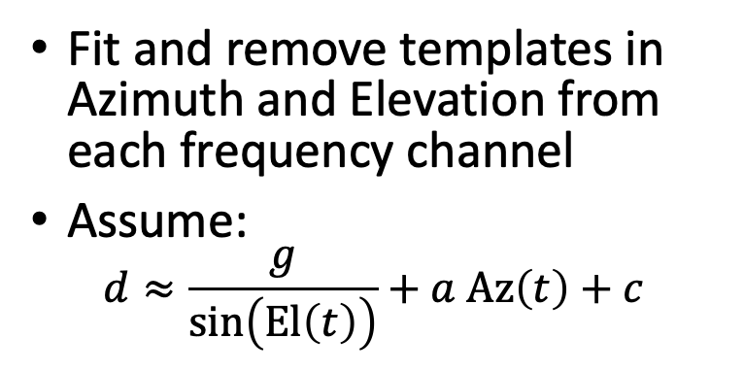

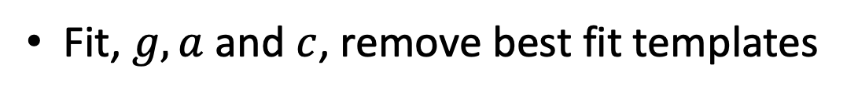

Az/El-template removal
Fit and remove templates in Azimuth and Elevation from each frequency channel
Assume:
  $$d≈\frac{g}{\sin\left(El\left(t\right)\right)}+a Az\left(t\right)+c$$
Fit, $g, a$ and $c$, remove best fit templates
$d_{after}≈$ $A∆τ\left(El\right)+ Δs_{cont}+Δs_{gnd}+n_{corr}^{G, i}\left(t\right)+n_{corr,ν}^{SW}\left(t\right)+n_{corr}^{atm}\left(t\right)+n_{w}^{ν,i}(t)$
$$=Δs_{cont}+n_{corr}^{G, i}\left(t\right)+n_{corr,ν}^{SW}\left(t\right)+n_{corr}^{atm}\left(t\right)+n_{w}^{ν,i}(t)$$

Slide 11




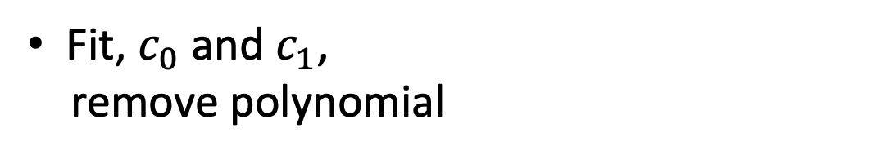
Polynomial continuum filter (“polyfilter”)
Fit and remove a linear polinomial in frequency, for each time step, to remove continuum contributions
Assume:
  $$d_{ν}≈c_{0}+c_{1}ν$$
Fit, $c_{0}$and $c_{1}$,
remove polynomial
$$d_{after}≈Δs_{cont}+n_{corr}^{G, i}\left(t\right)+n_{corr,ν}^{SW}\left(t\right)+n_{corr}^{atm}\left(t\right)+n_{w}^{ν,i}(t)$$

Slide 12
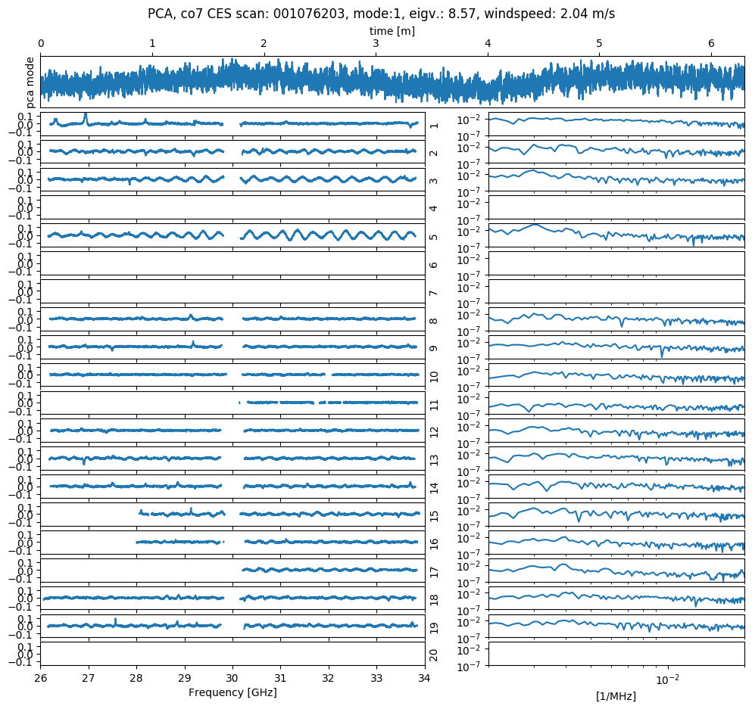
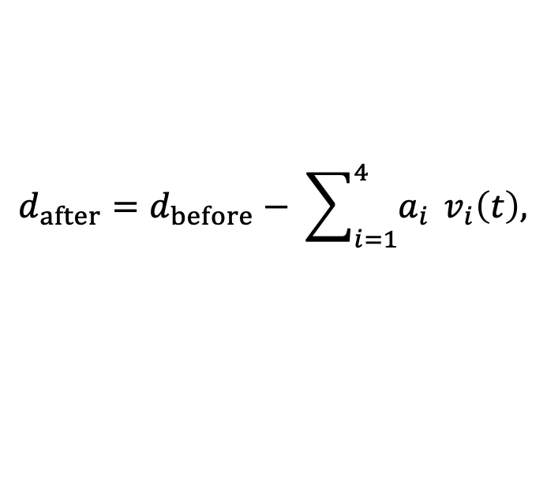

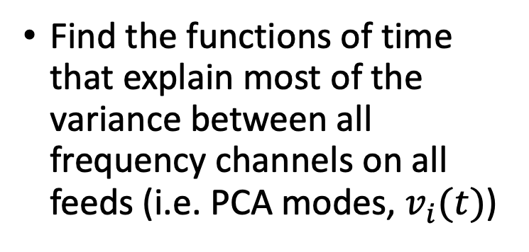
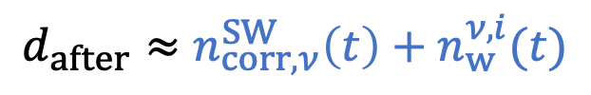

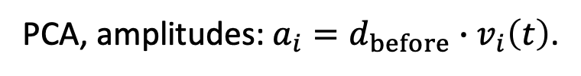

PCA filter
Find the functions of time that explain most of the variance between all frequency channels on all feeds (i.e. PCA modes, $v_{i}(t)$)
$$d_{after}=d_{before}− \sum_{i=1}^{4}{a_{i}} v_{i}\left(t\right),$$
PCA, amplitudes: $a_{i}=d_{before}∙v_{i}\left(t\right)$.
$$d_{after}≈n_{corr,ν}^{SW}\left(t\right)+n_{w}^{ν,i}(t)$$
$$=n_{w}^{ν,i}(t)$$

Slide 13
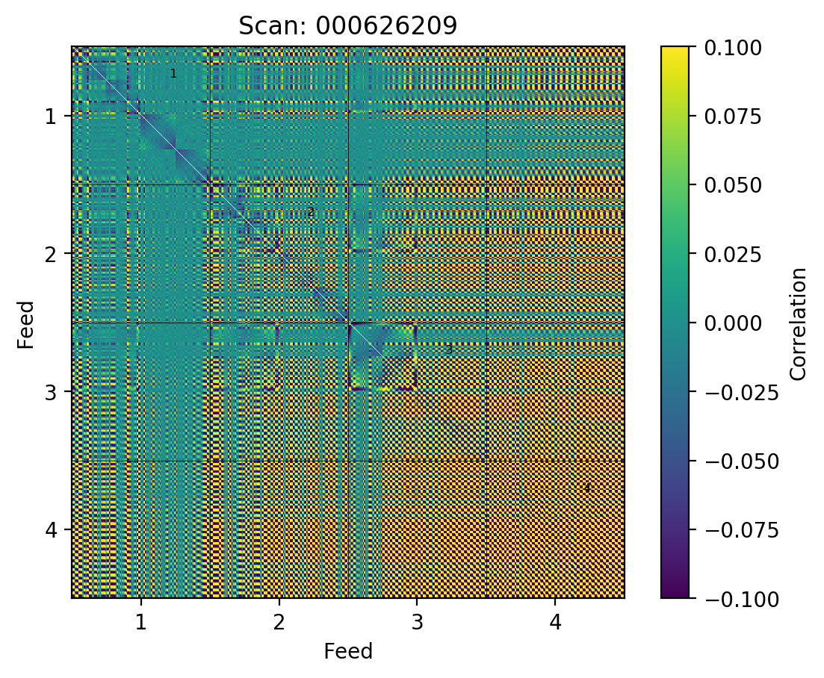
Correlation plot
After polynomial continuum filter (before PCA filter)

Slide 14
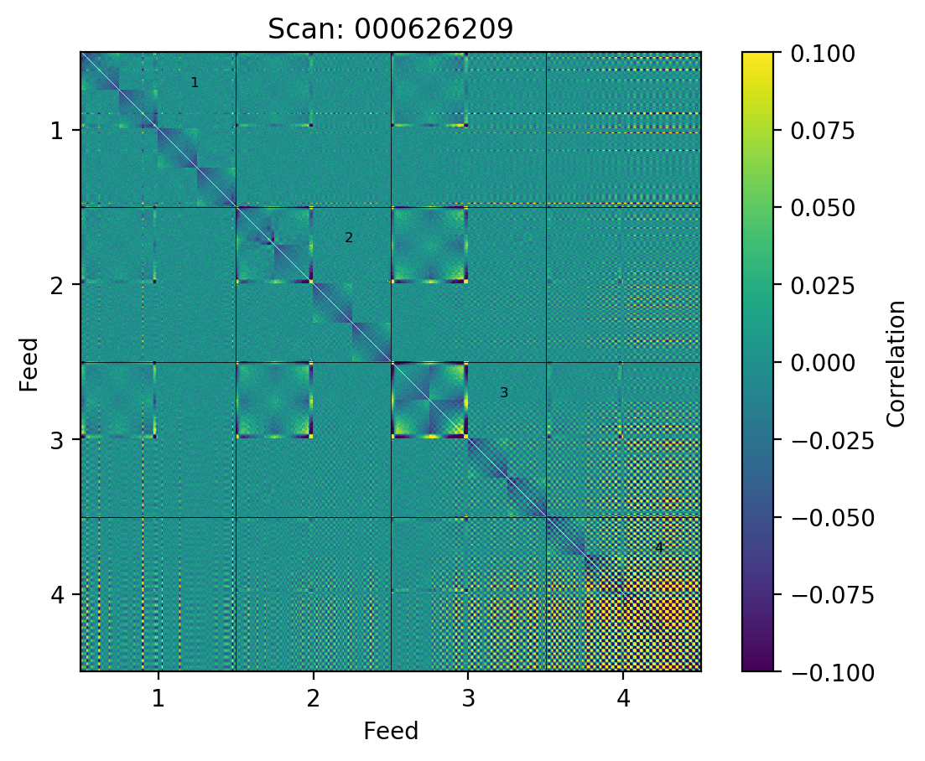
Correlation plot
After removing 1 PCA mode

Slide 15
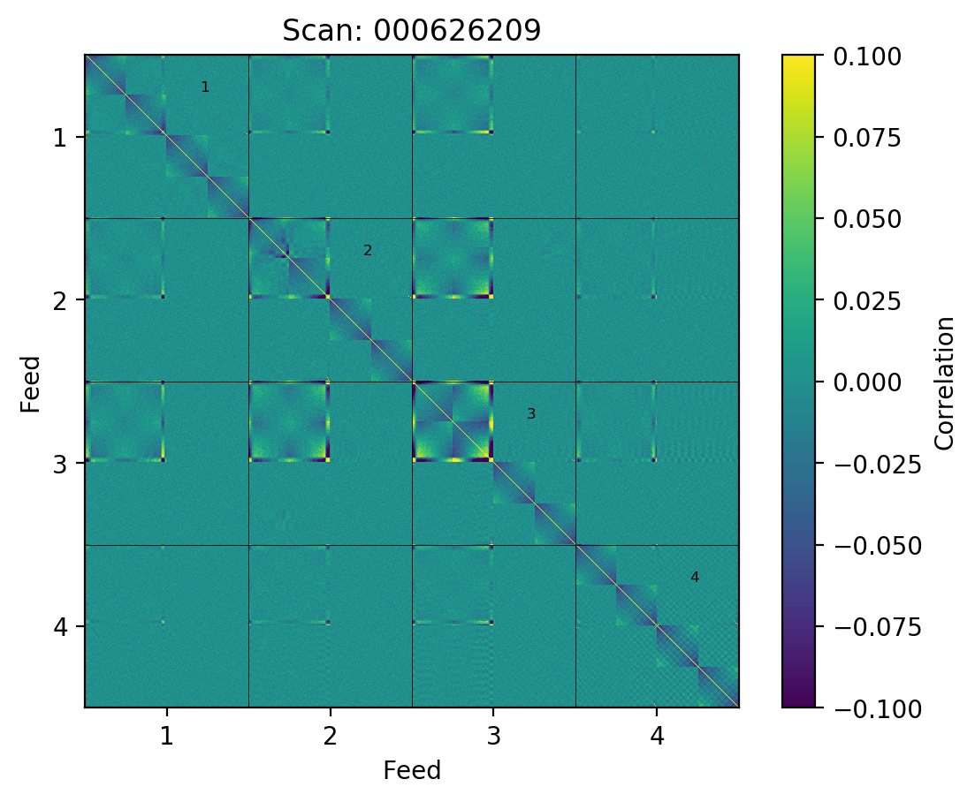
Correlation plot
After removing 2 PCA modes

Slide 16
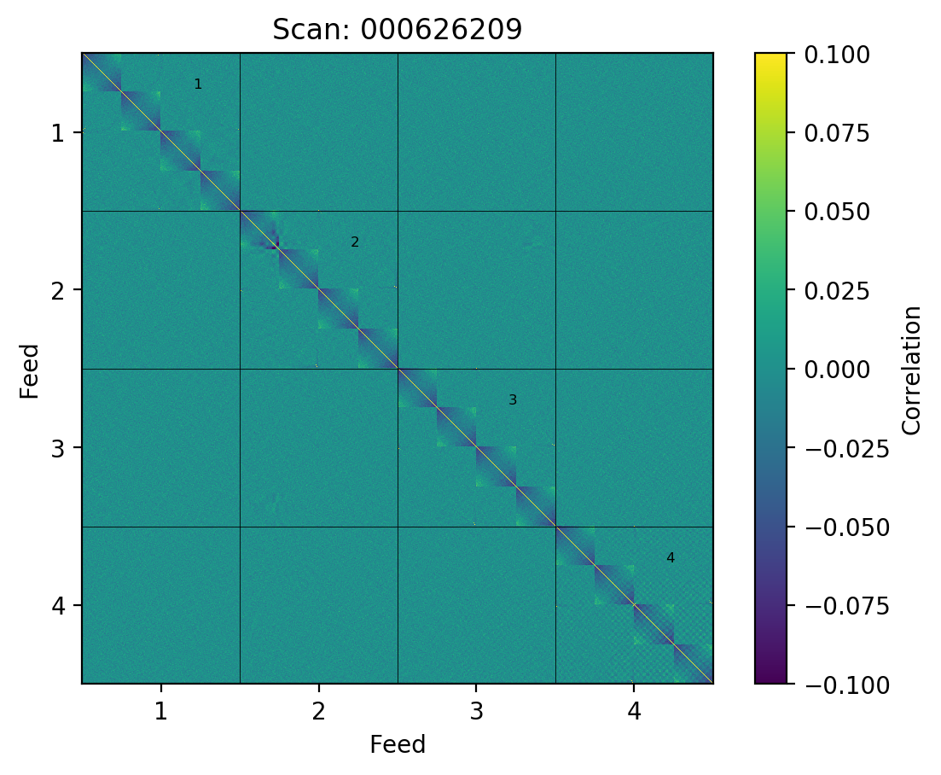
Correlation plot
After removing 3 PCA modes

Slide 17
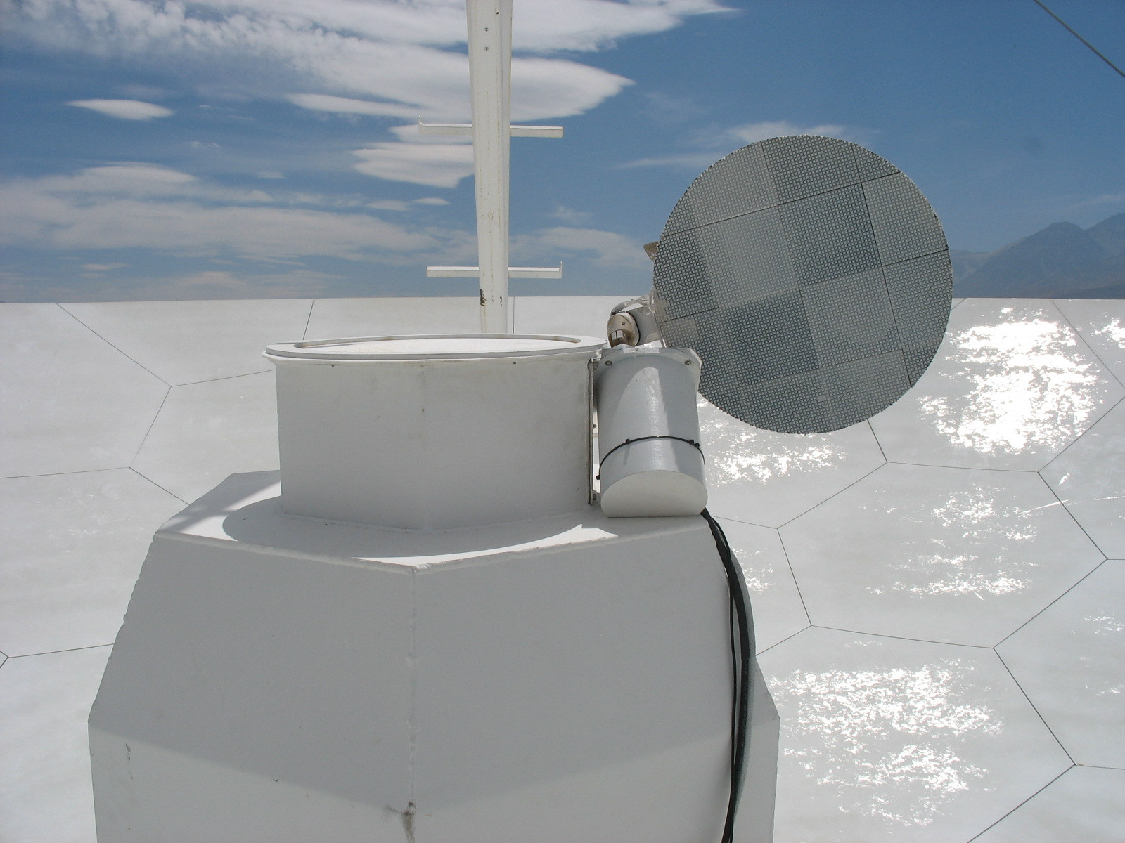

Total power calibration
Calibration using an ambient vane that moves in front of the receiver, converts data back to kelvin
$$d_{after}=d_{before}{T^{i}}_{sys,ν}$$
Calibration vane

Slide 18
Low level data analysis
Use several filtering steps to remove systematics and correlated noise
Calibrate and prepare the data for mapmaking
Credit: J. S. Lunde
Credit: J. S. Lunde

Slide 19
Systematics
Far sidelobes
We have several systematics affecting our data, including atmospheric noise, gain fluctuations, standing waves and ground contamination
Credit: J. Lamb
Ground contamination
Credit: J. S. Lunde
Standing waves

Slide 20
Data selection
Statistics database
Gather a large number of statistics for each chunk of data
Implement cuts on the parameters to remove badly performing data
Where do we lose data?
(1. year)

Slide 21
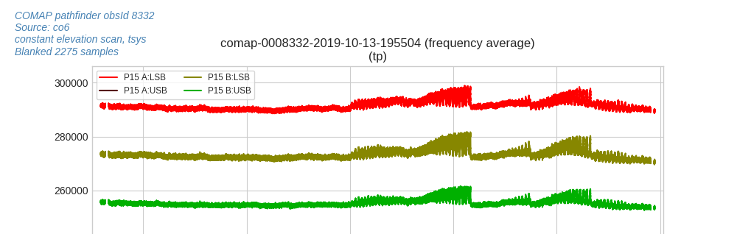
Sun in the far sidelobes

Slide 22
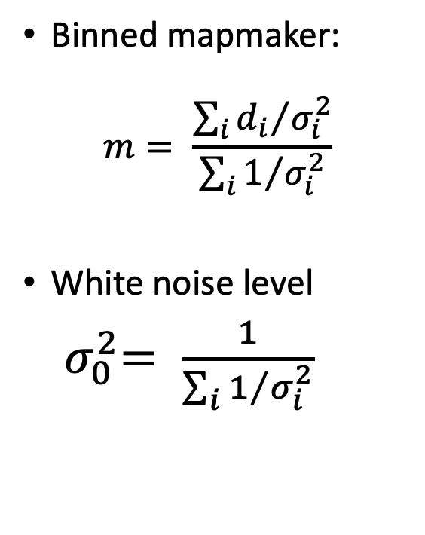
Mapmaking
Binned mapmaker:
$$m= \frac{{\sum_{i}{d_{i}}}/{σ_{i}^{2}}}{{\sum_{i}{1}}/{σ_{i}^{2}}}$$
White noise level
${ σ}_{0}^{2}= \frac{1}{{\sum_{i}{1}}/{σ_{i}^{2}}}$

Slide 23
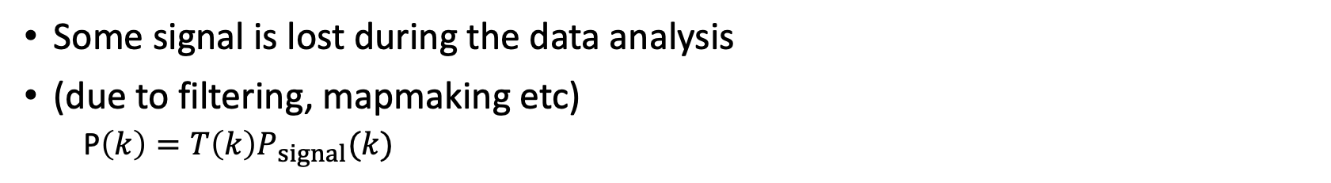
Transfer function
Beam model
Some signal is lost during the data analysis
(due to filtering, mapmaking etc)
  P$\left(k\right)=T\left(k\right)P_{signal}(k)$
Pipeline transfer function
Beam transfer function
Credit: N. O. Stutzer

Slide 24
Supplementary slides

Slide 25
Power spectrum methods
Auto spectrum
Cross spectrum
2
X
Map 1
Map 2
Auto spectrum needs very precise noise estimate
Noise does not bias the cross spectrum
Cross spectrum only sensitive to stuff common to both maps (great for systematics rejection!)

Slide 26
Feed-feed Pseudo-Cross-Spectrum (FPXS)
Cross spectrum method designed to be maximally robust to systematics
Algorithm:
  Split data in two parts (taken at high/low elevations)
  Make 19 feed-maps for each of the two parts
  Calculate cross spectra of all combinations of different parts and different feeds
  Take the noise weighted average
This makes the estimate insensitive to systematics present in only one part or a particular feed
Note, pseudo-spectra use noise-weighted and masked maps (a neccesary hassle!)
CES
Lissajous
Credit: J. Borowska

Slide 27
CO power spectrum constraints and forecast

Slide 28
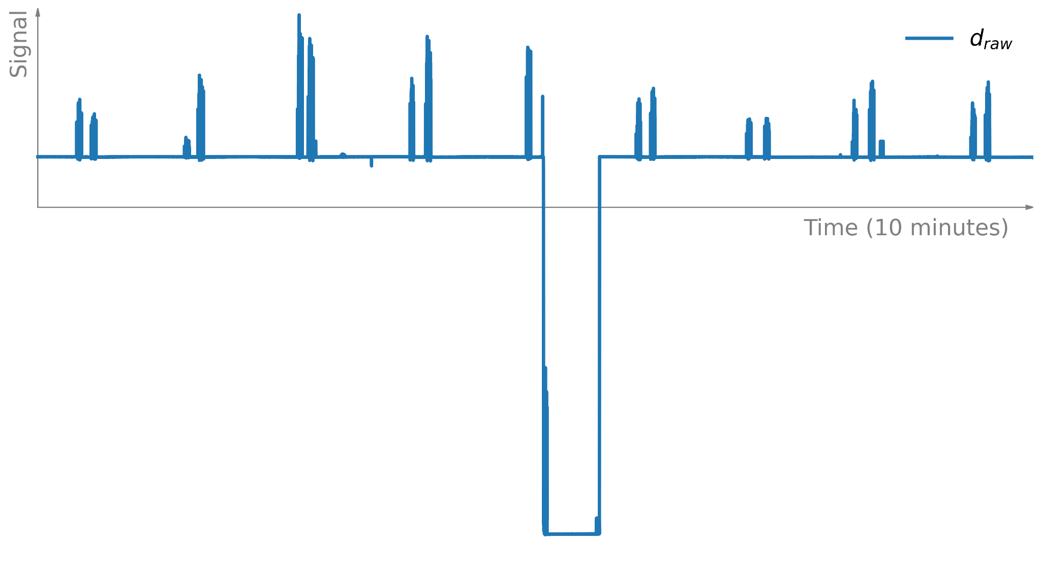
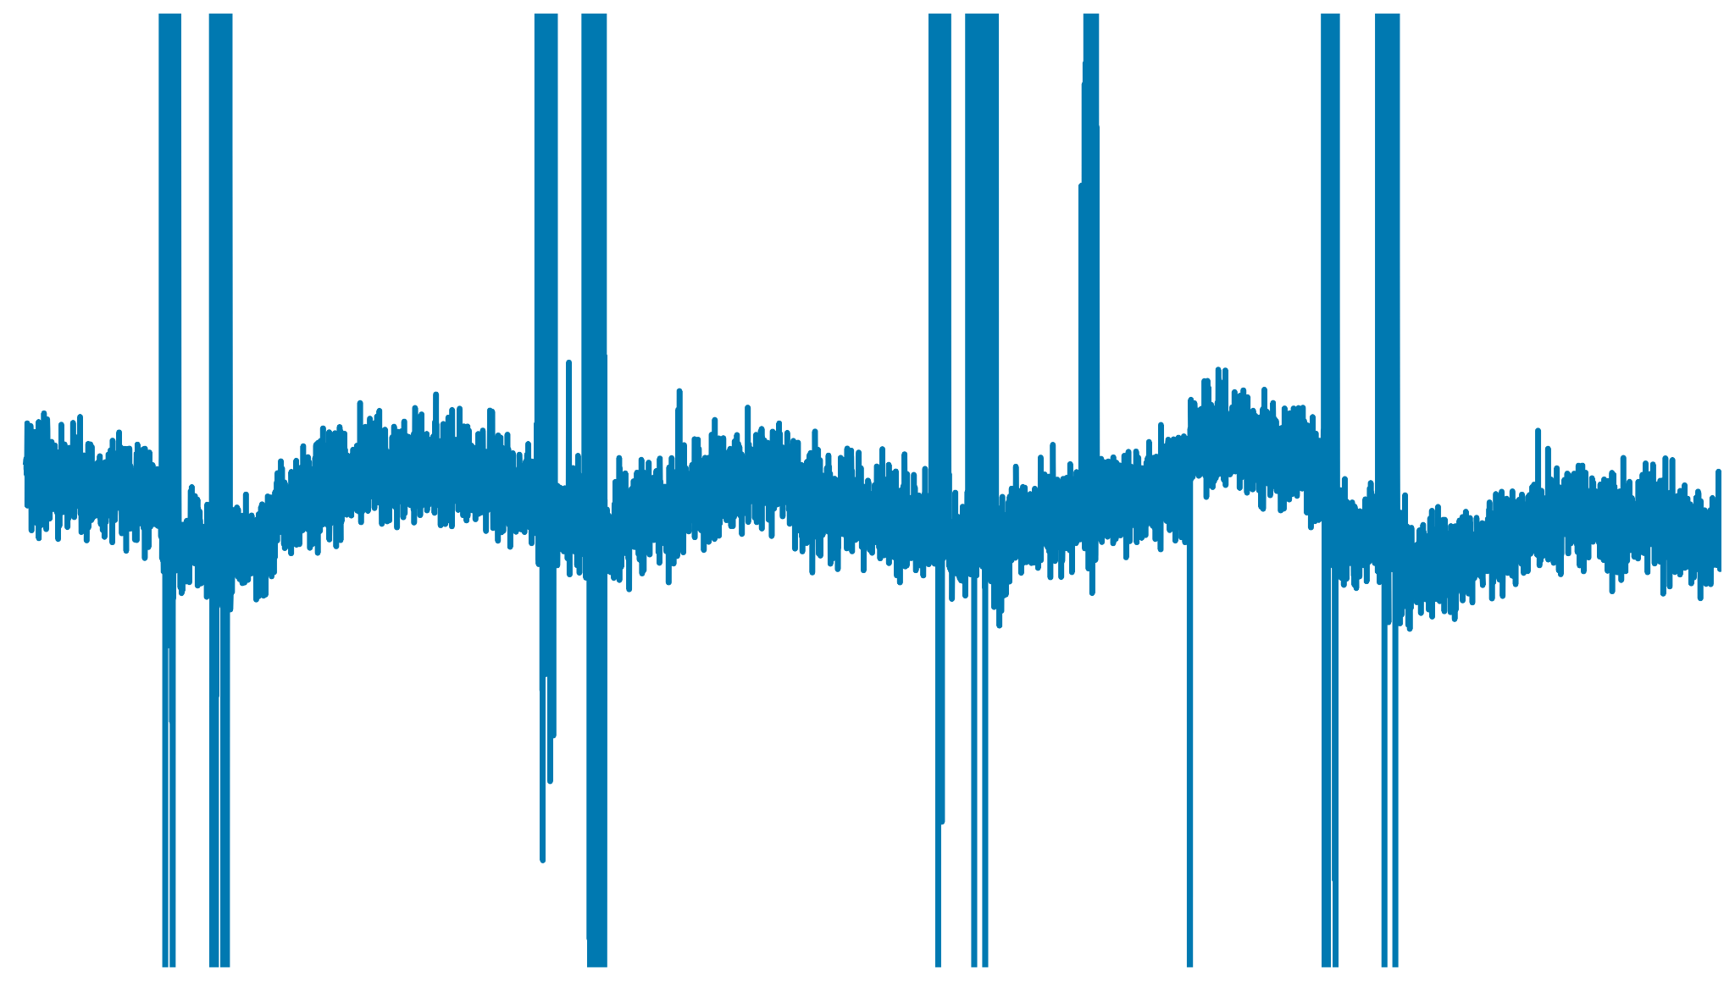
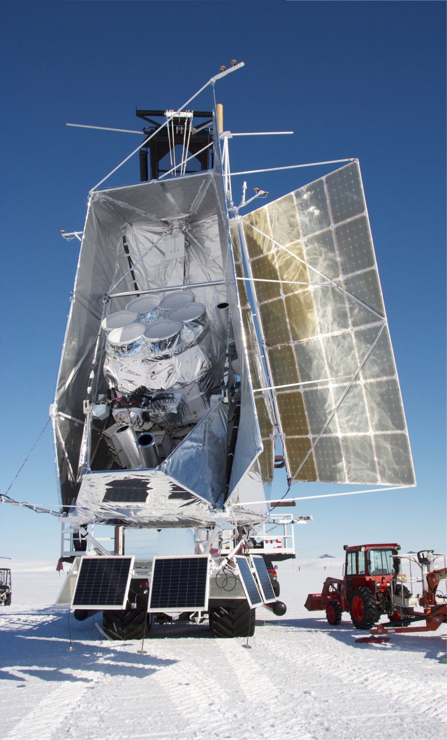

Systematics for balloon exp.? (Raw SPIDER data)
Image credit: J. Shariff
Slide credit: H. Thommesen

